Slide 1
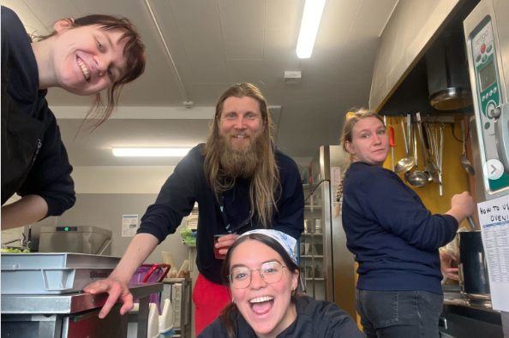

The Practicalities
An introduction to life at Úlfljótsvatn
www.ulfljotsvatn.is/training

Slide 2



Apps for your phone
Sling, Slack and Calendar

Slide 3
Weekly meetings
Every Friday (when possible)
After group departure OR end of day
  30 minutes: Volunteer meeting / Coordinator meeting
  50 minutes: Staff meeting
  10 minutes: Operational meetings
Before or after meeting: Cleaning
In meetings we sync the team, share information and evaluate the week.
Remember: Our „doors“ are always open ☺

Slide 4
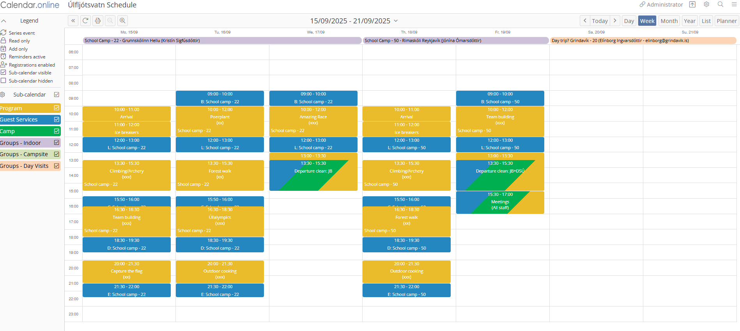
Weekly Overview

Slide 5
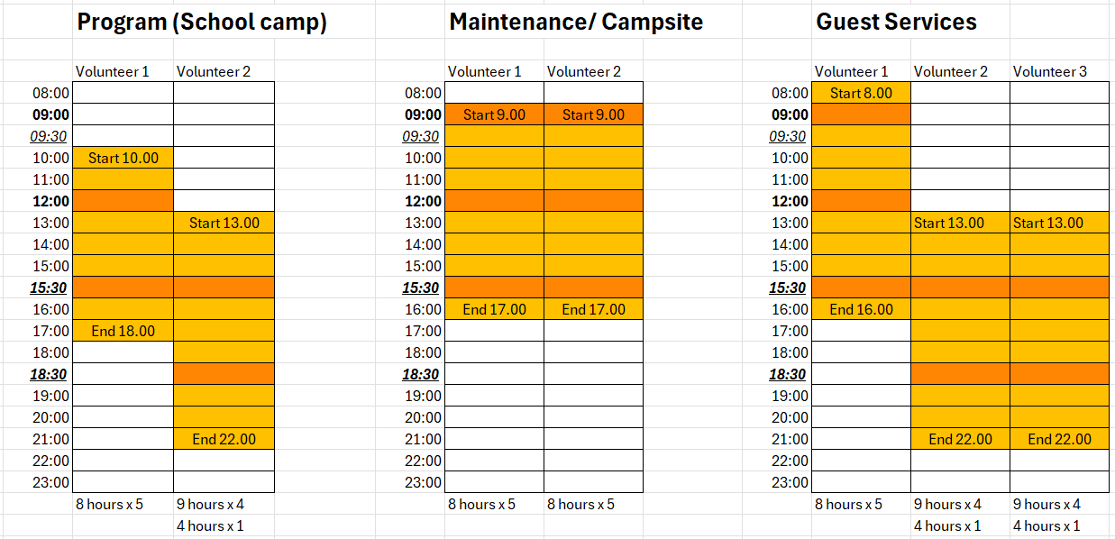
Shift Times - Example

Slide 6
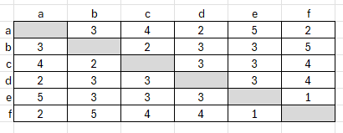
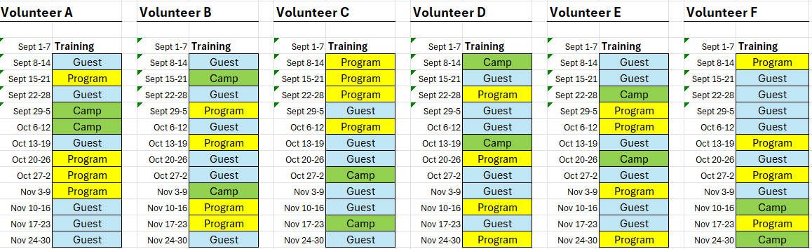
Shift Schedule

Slide 7
Staff Benefits
What you get
Free accommodation and meals during work and days off
2 days off per week
Use of centre equipment (when not in use by guests)
Provided with bedding and towels, as well as laundry facilities
4 guest-nights per season (pre-approved guests only)
Regular staff activities (SEA / SADA)
Use of center vehicles (Yaris and Duster)

Slide 8
General Centre Rules
Do’s and don’ts
Work-day starts on the minute (DON'T BE LATE)
Full uniform must be worn during work times
Uniform should be removed while not working
If sick or unable to work, notify managers ASAP by Slack
No alcohol on site
Alcohol should not be consumed at all by those under the legal age (20)
No smoking in or around the buildings (designated spot?)
Be nice to each other

Slide 9
Communication is Key
Be respectful to each other, guests and the center
Plant happy seeds – say nice things to each other
Stay away from passive aggression, favoritism, exclusion, bullying and other bad habits
Respect the needs of others, such as personal space, alone time and so on
Accept that others may not have the same needs, habits or believes as yourself
If you need to, give constructive feedback
Keep in mind that lack of sleep can affect mental health
– take care of yourself and others
If you have any concerns, feel free to talk to any of the managers

Slide 10
Four point system for misconduct
In case of misconduct, a staff member might receive 1 or more points and a warning from a manager. Should a staff member earn a total of 4 points during their stay, their stay/employment is terminated.
1 point
Minor negligence of conduct (manners, duty, care or safety)
Examples:
Repeatedly showing up late, or not putting enough effort into work (first warning)
Repeatedly spreading negativity within the team, either pointed at Úlfljótsvatn, guests or staff (first warning)
2 points
Intermediate negligence of conduct (manners, duty, care or safety)
Examples:
No-show without prior approval, or leaving post/shift without approval (for every shift)
Drinking on site or smoking in or around the buildings
Participation in any form of bullying, racism or other discrimination
4 points
Gross negligence of conduct (manners, duty, care or safety)
Examples:
Threats or acts of physical or sexual violence/abuse, including online

Slide 11
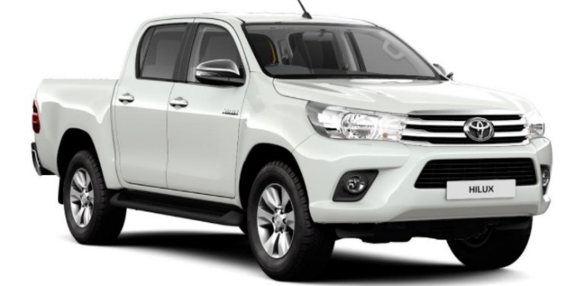
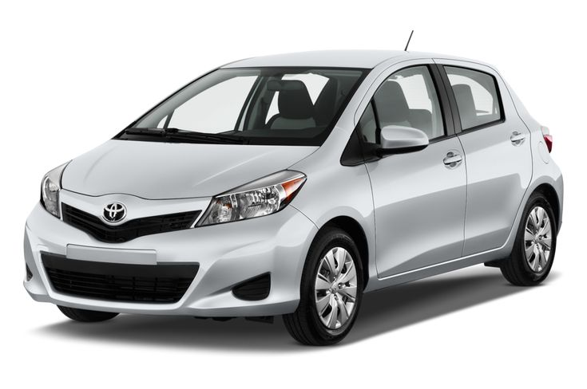

Cars
Hilux is a work vehicle
Not to be used for personal use or trips
Yaris is for personal use and trips (and sometimes work)
Coordinator team is responsible for Yaris, and primary users
Duster is for personal use and trips (and sometimes work)
Volunteer team is responsible for Duster, and primary users

Slide 12
Cars
Who can drive a center car?
Any staff member with valid driving license, if they pass a driving assessment and sign a vehicle agreement.
How to pay for fuel?
Hilux: Card inside car. Fill up if tank is less then half.
Yaris and Duster: Users pay for fuel and should fill up after every trip.
(If work use, fill up the used amount by buying invoiced fuel, before driving to center)
(Before SADA and such, drivers must fill up Yaris and Duster so they are full at the start)
Who is responsible, in case of accident?
The driver (as per traffic law).
Can the cars go in space?
No.
Also not on any F-roads, or roads 35, 52 or 550.
Yaris can not go on gravel roads.

Slide 13
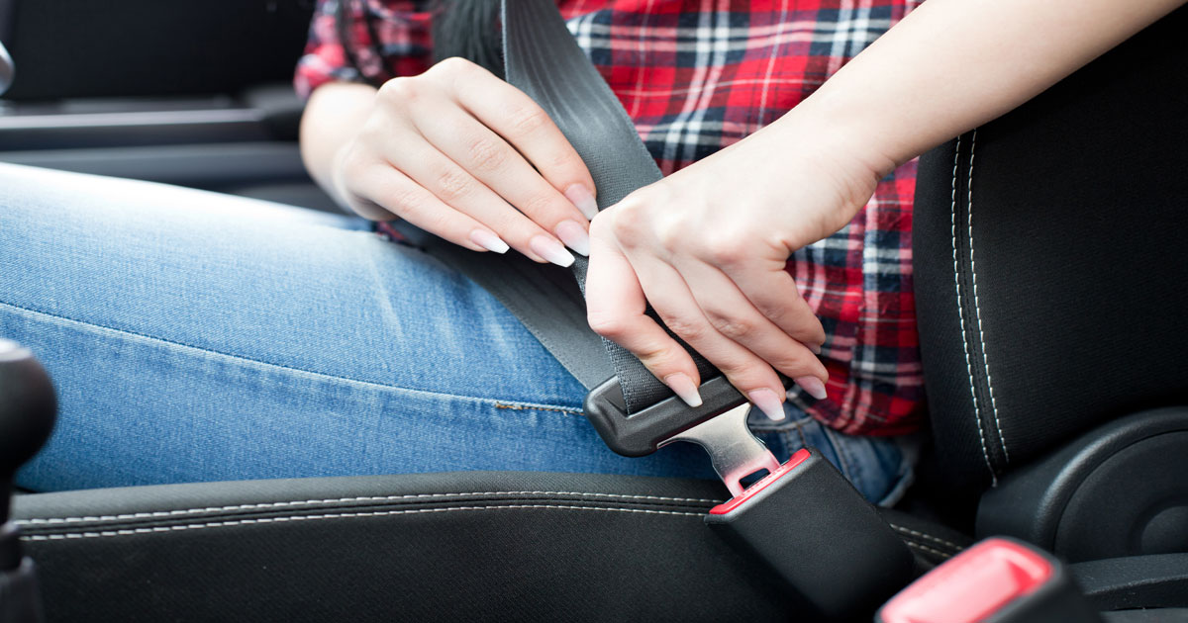
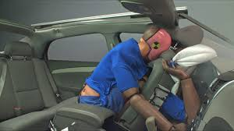
Seat belts
Always
No matter how short the trip
Every seat
Also in the back
It‘s the law
Also, don‘t be stupid

Slide 14
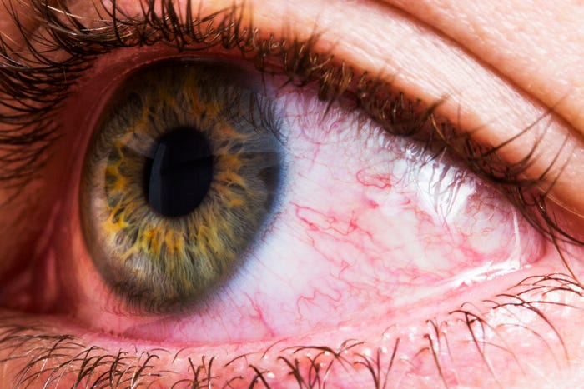

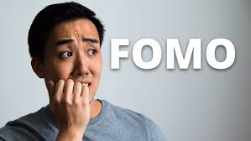
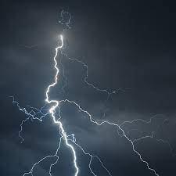
Known pitfalls for volunteers

Slide 15
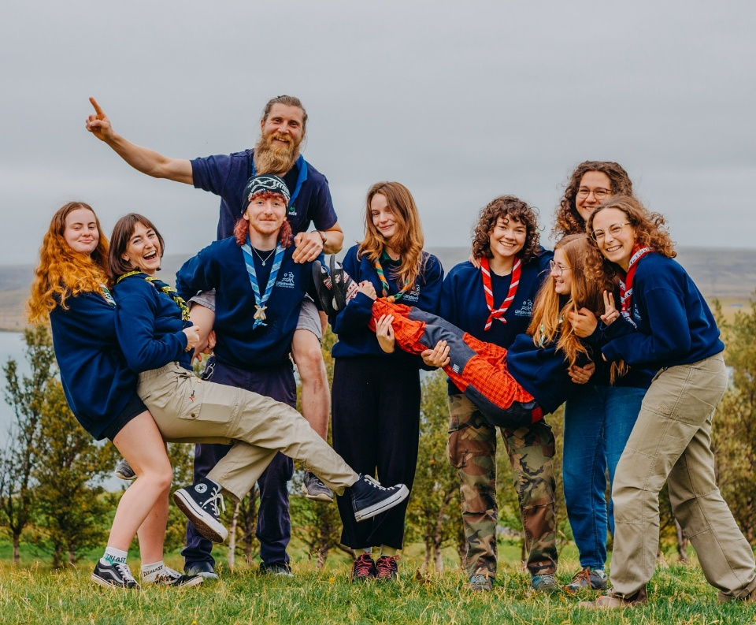
Finally…
Keys
Put your name on the label NOW.
Do not lose them.
Shifts
Option to change schedules today
Option to change shifts (with approval of manager)
Photos
On Friday, at end of training
With neckerchief, in staff uniform (also group photo)

Slide 16
