Slide 1
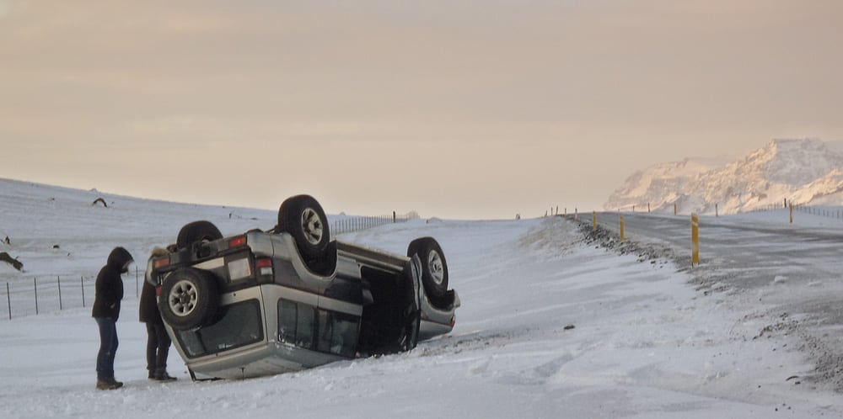

Driving in Iceland
“People die there”

Slide 2
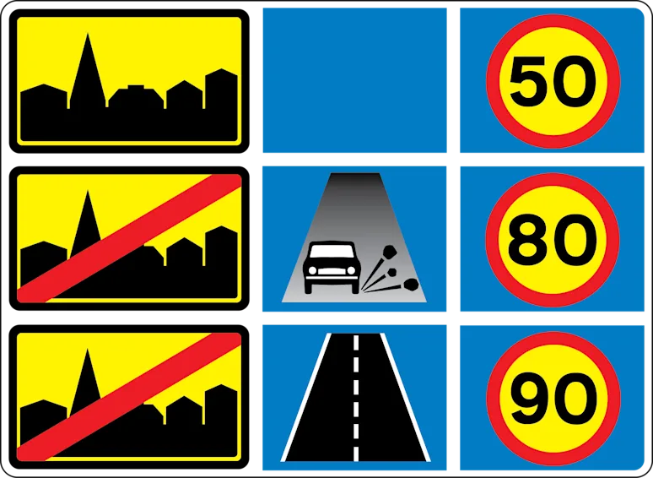
Speed limit

Slide 3
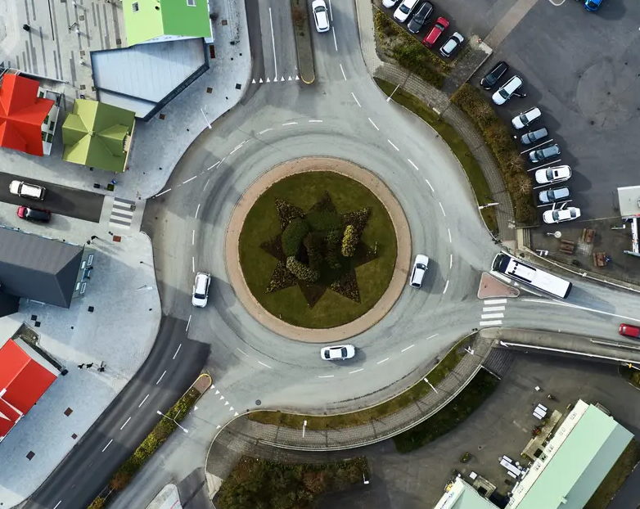
Roundabouts

Slide 4
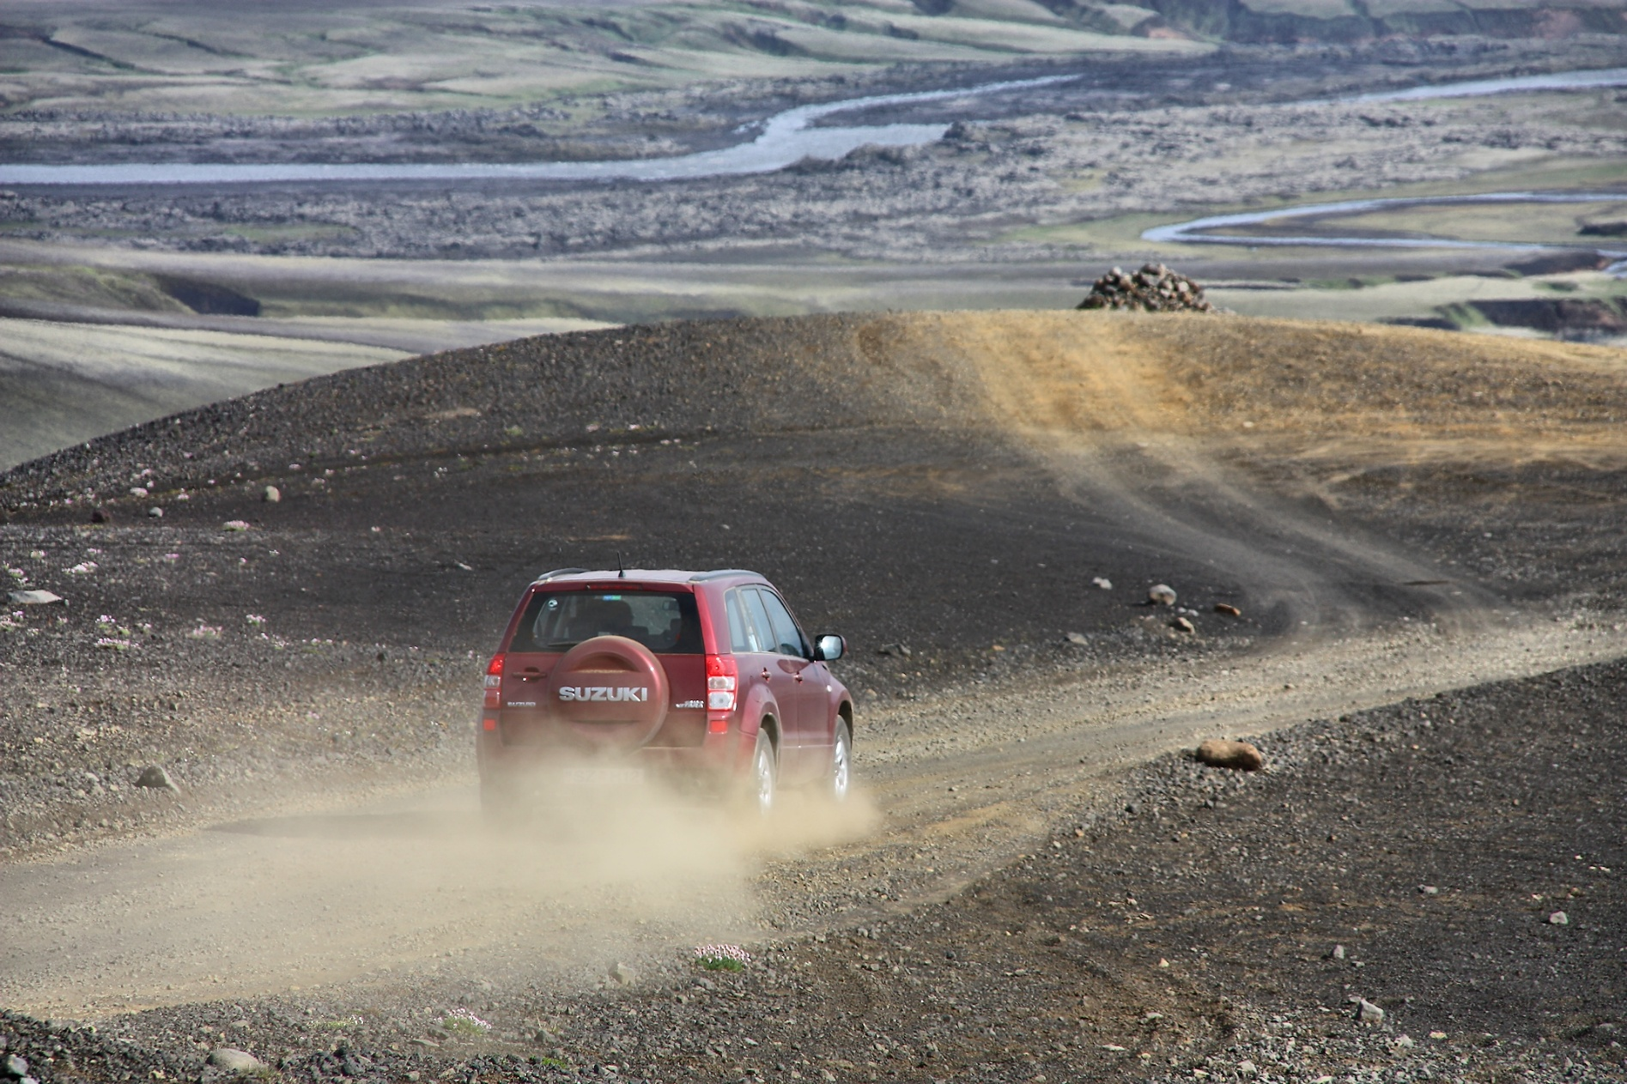
Gravel

Slide 5
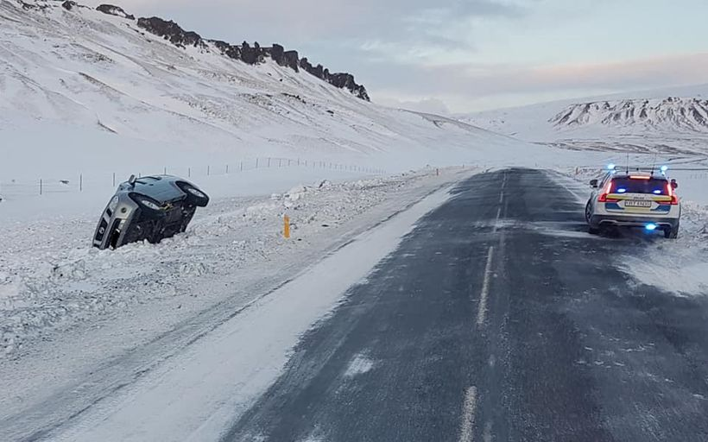
Snow and ice
Notes:
Less grip, really slippery sometimes.
Lower speed, soft movements, slow down earlier, accelerate slower, leave good space inbetween cars

Slide 6
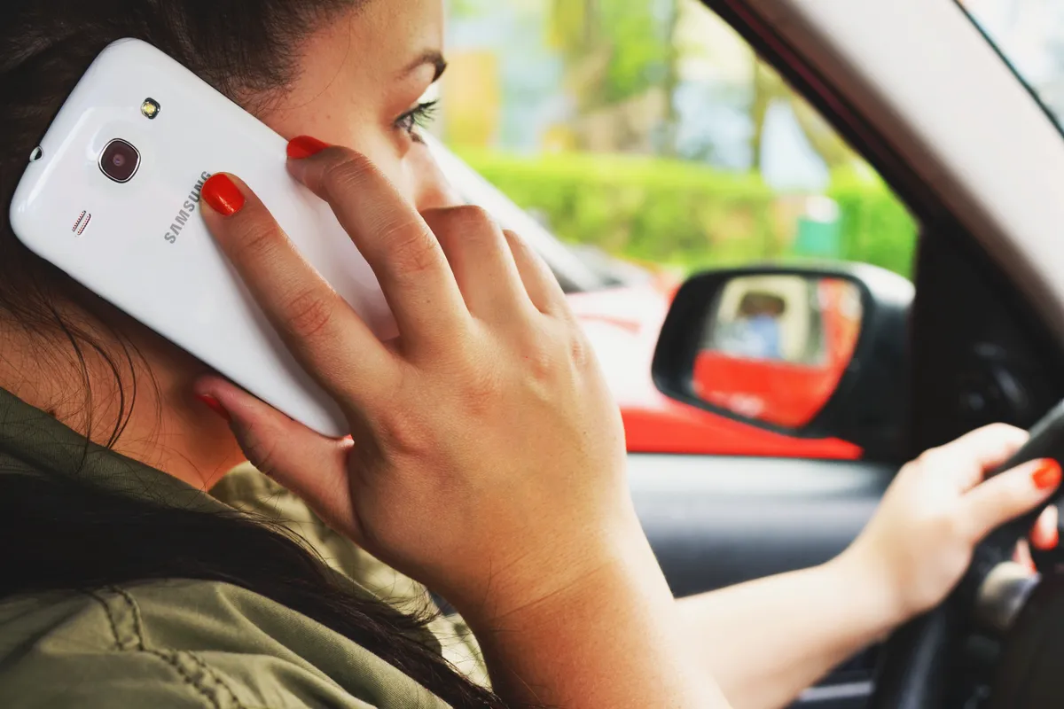
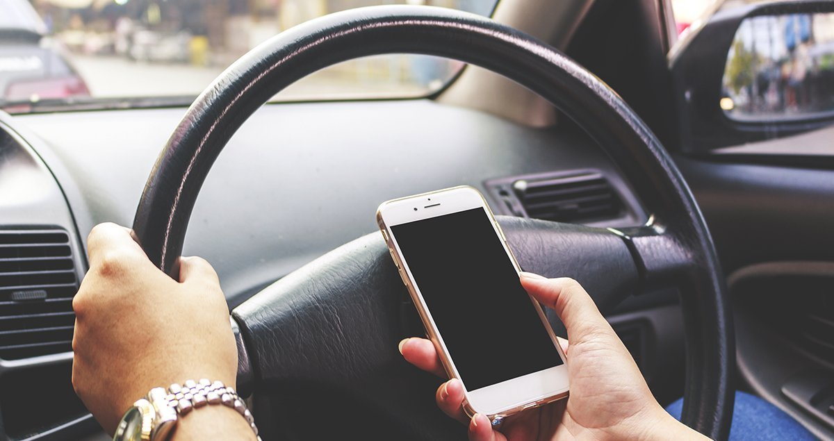
Mobile phones/smart devices
Notes:
40.000 kr.

Slide 7
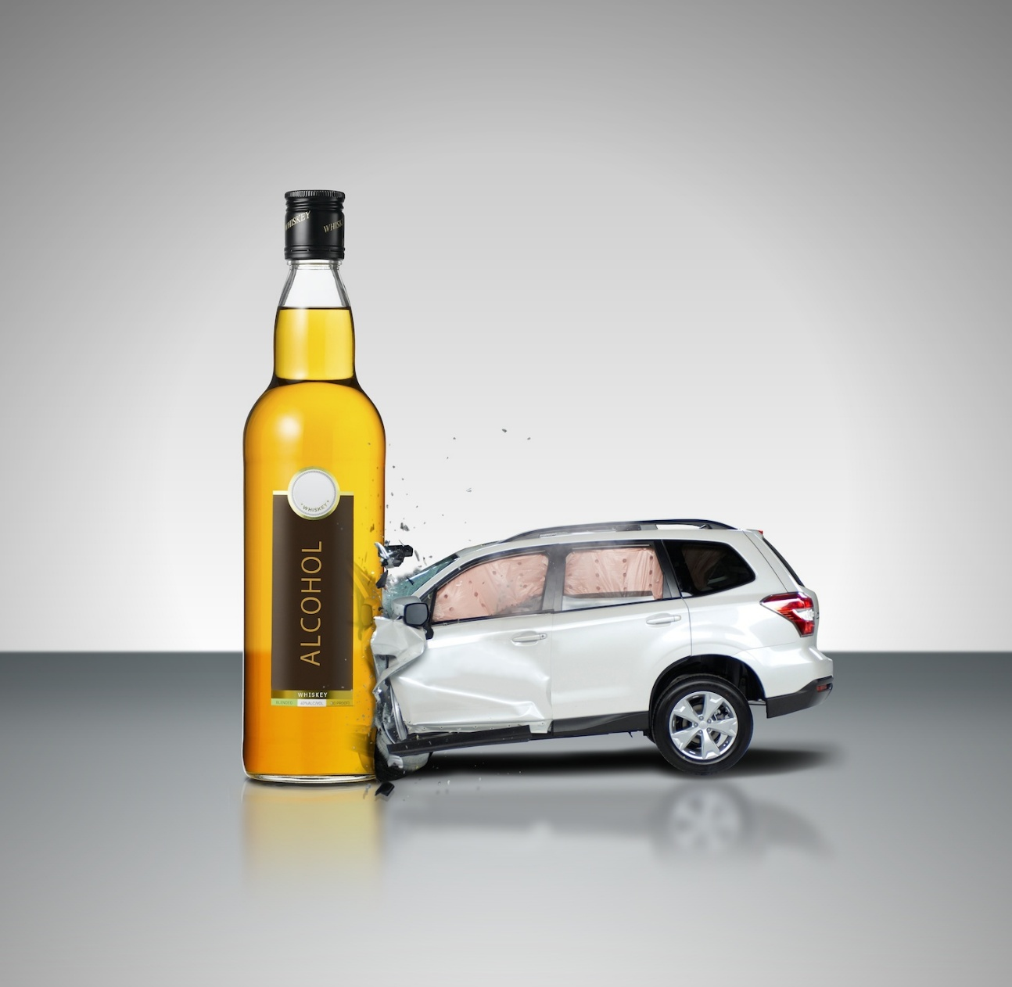
Alcohol and driving
Notes:
Zero tolarance

Slide 8
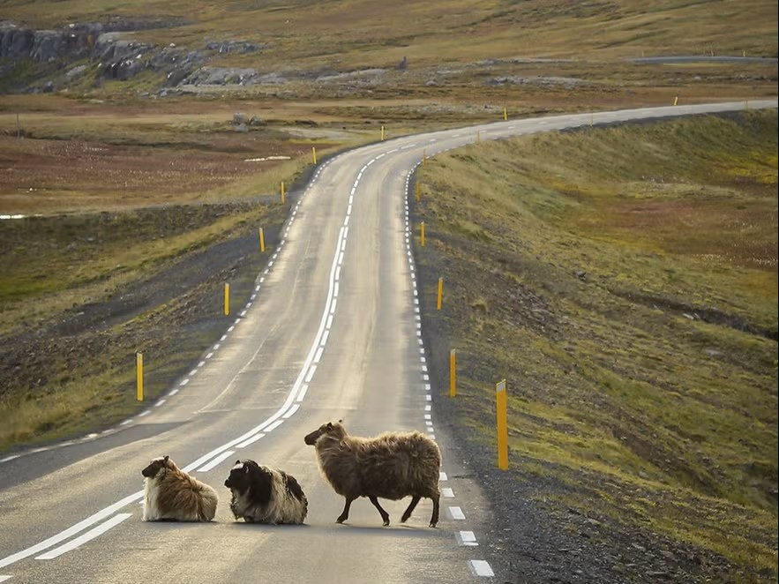
Live stock

Slide 9
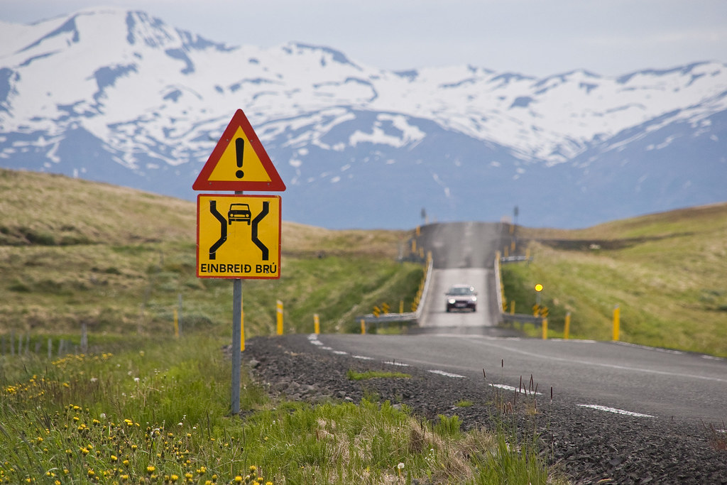
Single lane bridges

Slide 10
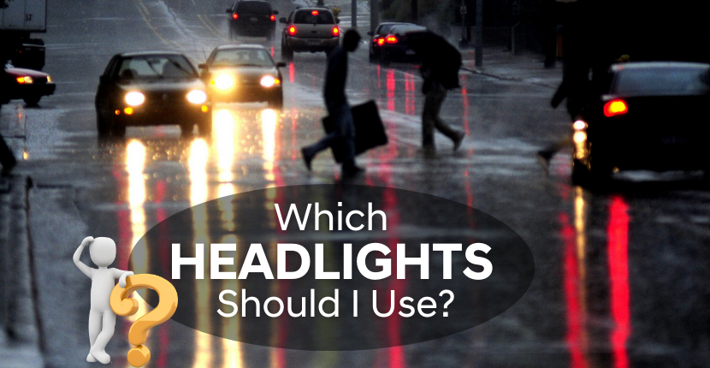
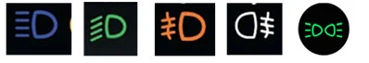
Lights when driving

Slide 11
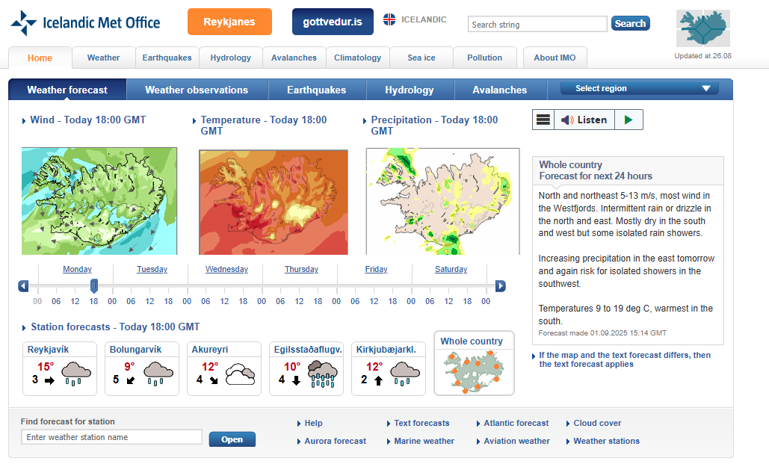
Weather forcast
en.vedur.is

Slide 12
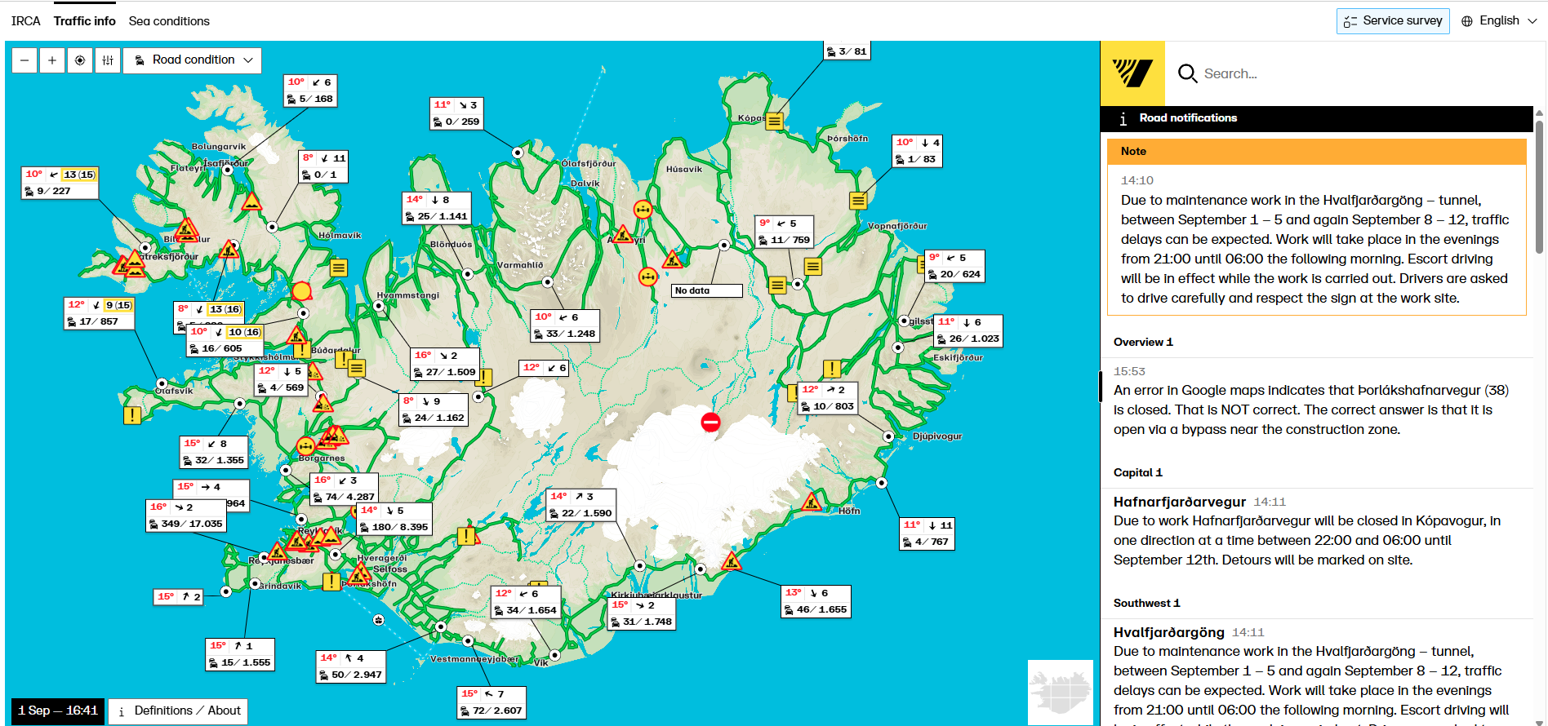
Road conditions
road.is

Slide 13
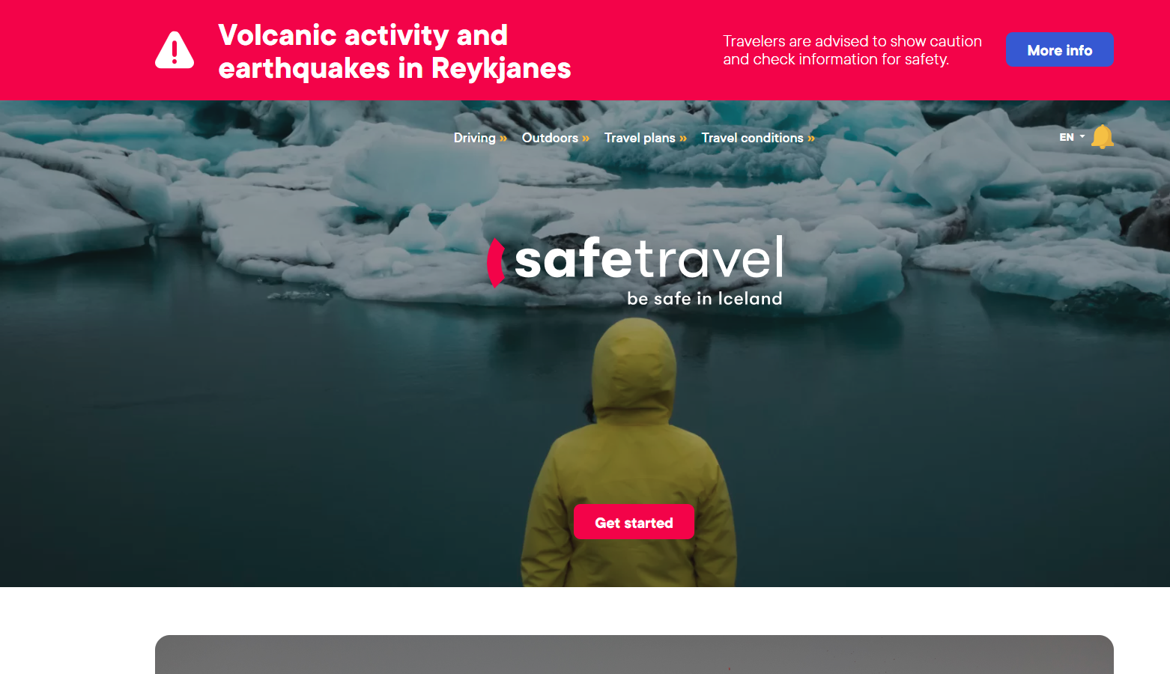
Dangerous stuff
safetravel.is

