Slide 1
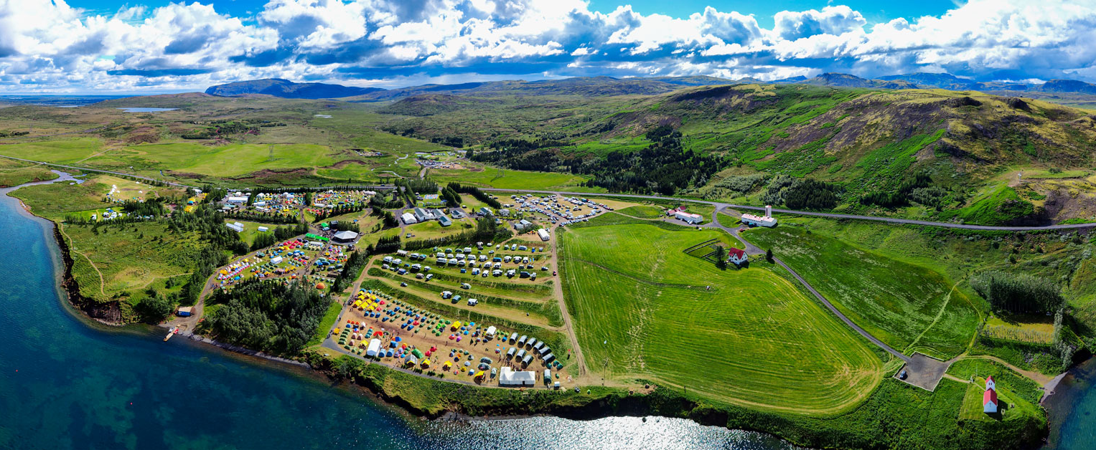
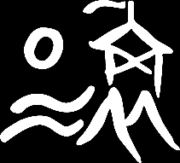
Welcome to ÚSÚ
An introduction to Úlfljótsvatn
Photo: Jakob Guðnason

Slide 2
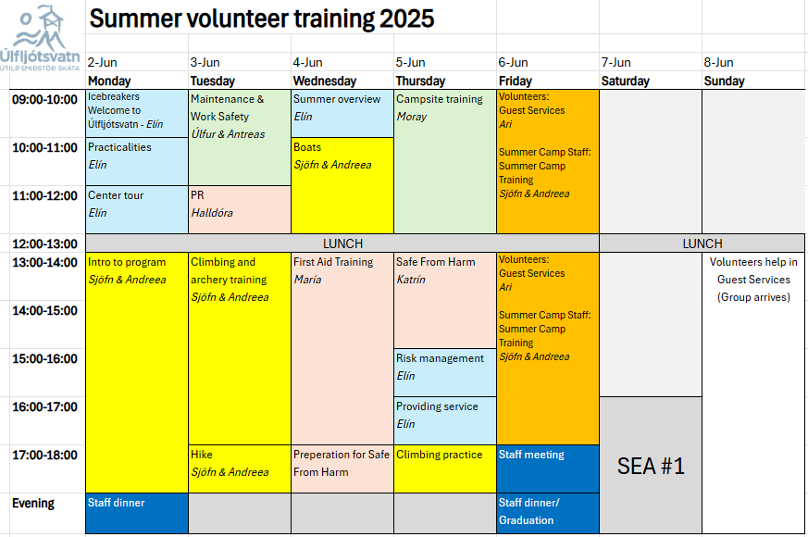
Training week
The best week of the season … so far!

Slide 3
Let’s start with the basics

Slide 4
Let’s start with the basics
Úlfljótsvatn

Slide 5
Let’s start with the basics
Úlfljótsvatn
Oolf – lyots – vhat – n

Slide 6
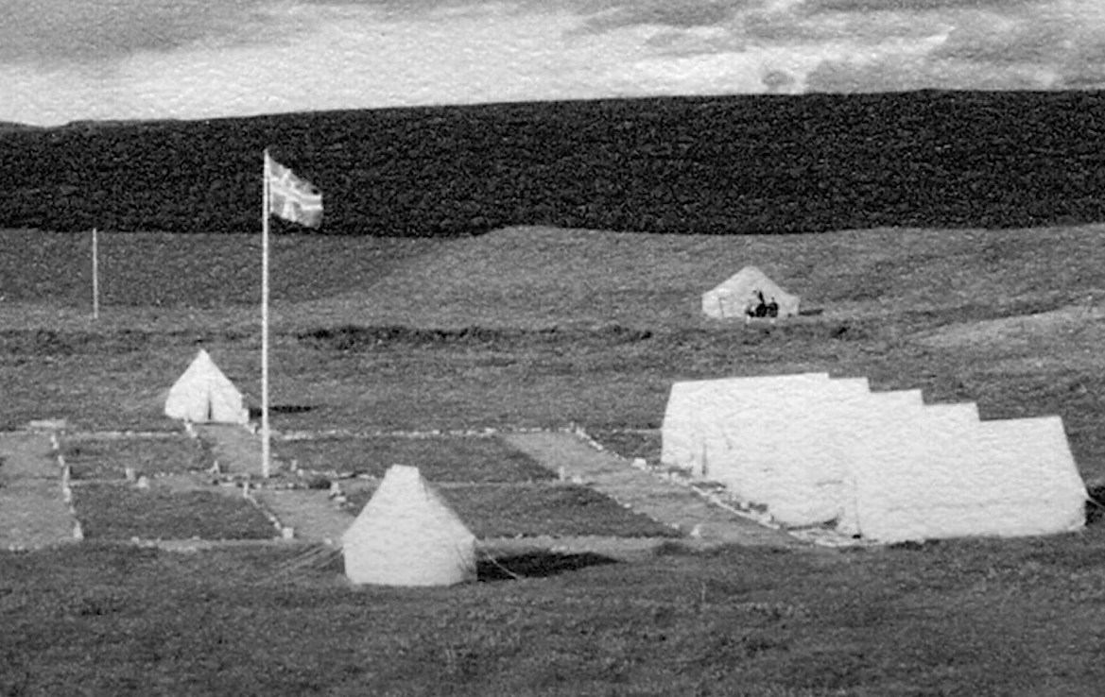
Some history
Scouts in Iceland since 1912
First Summer Camp in
Úlfljótsvatn 1941
First building 1942
First National Jamboree
(at Úlfljótsvatn) 1974
Scouts have planted trees
since 1990
First School Camp 1992
Scouts and Forestry Association
buy the land in 2011

Slide 7
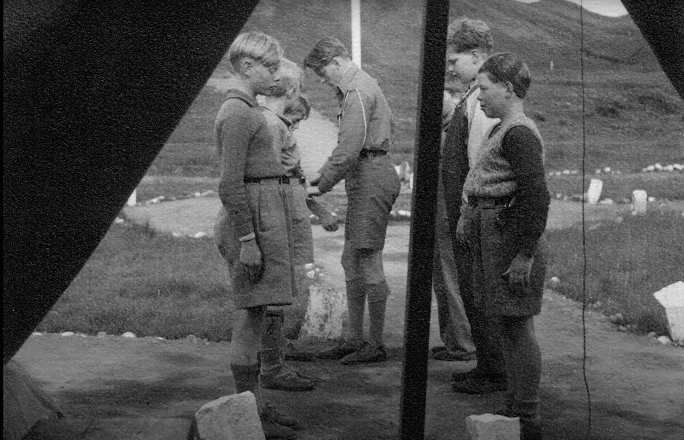
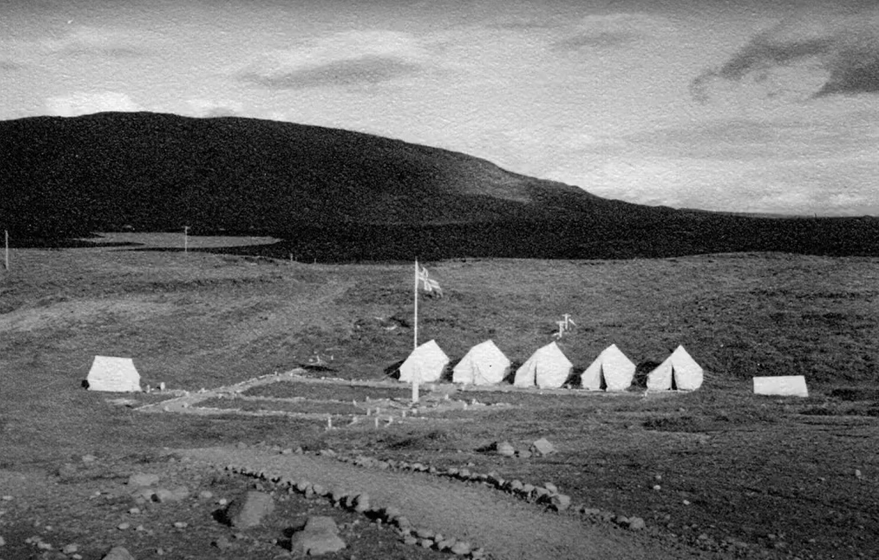

Slide 8
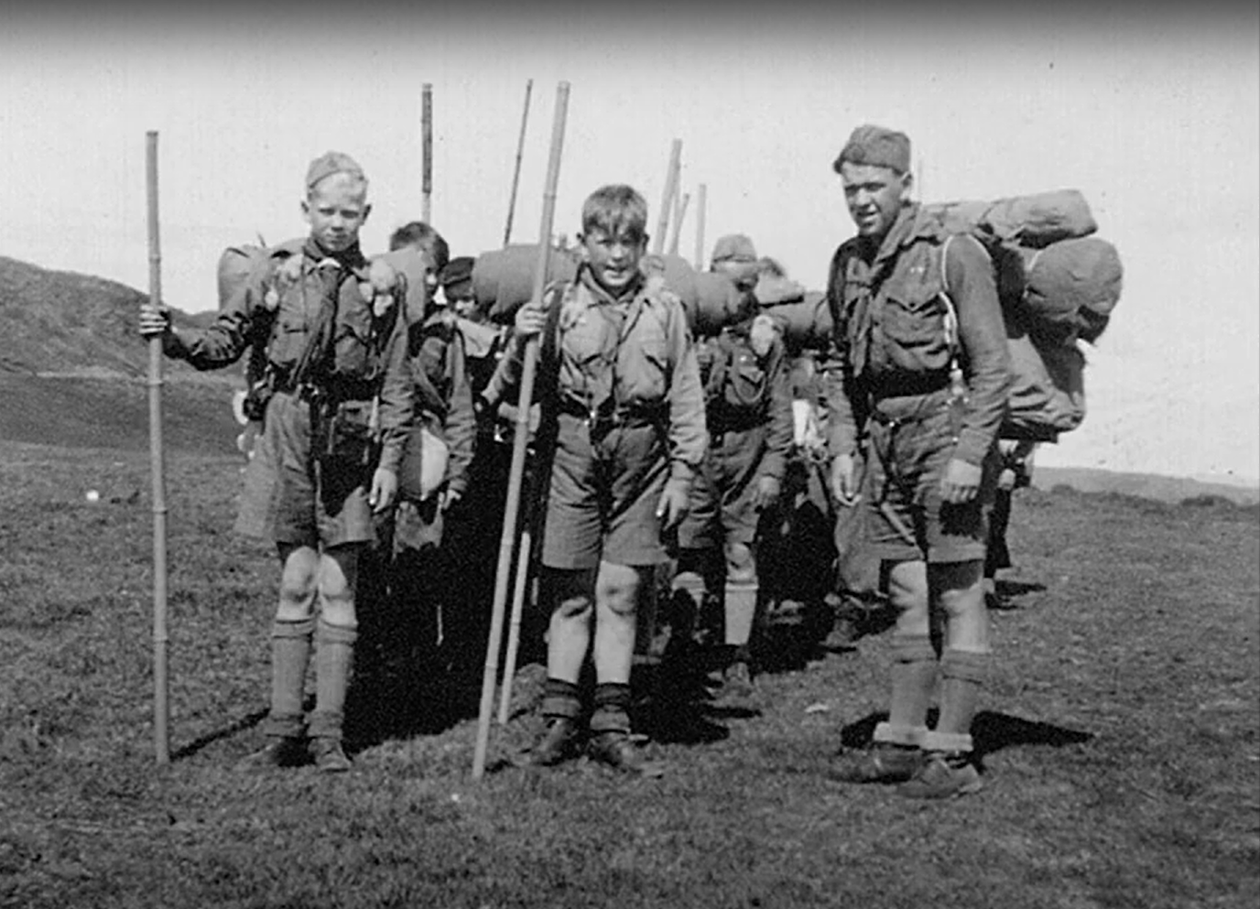
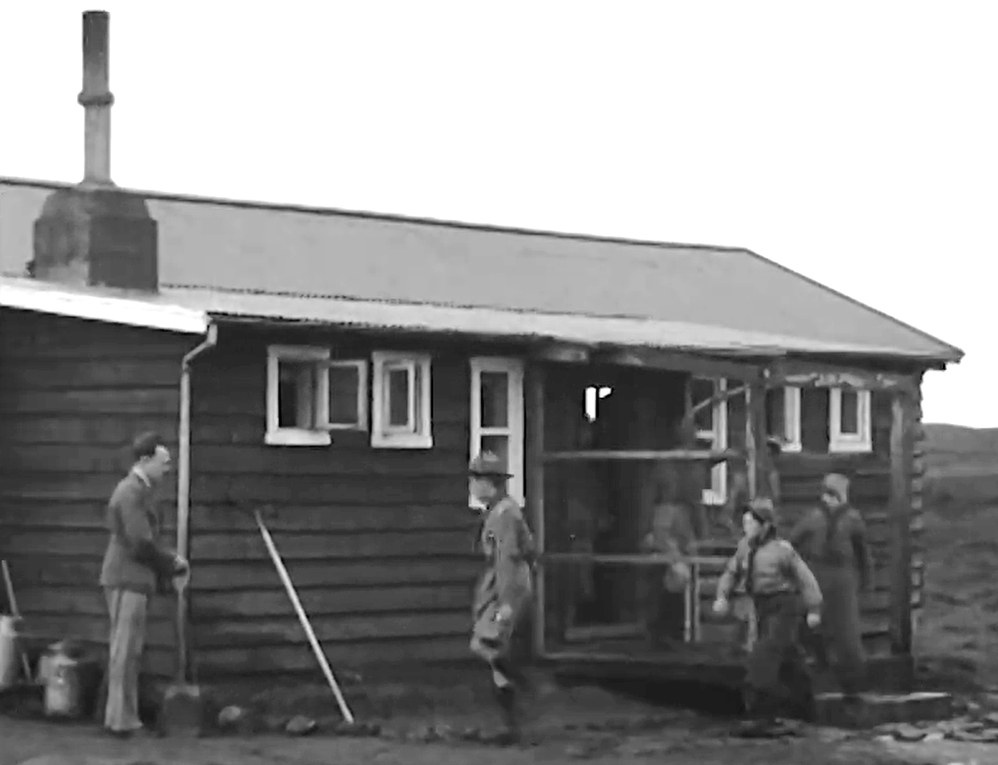

Slide 9
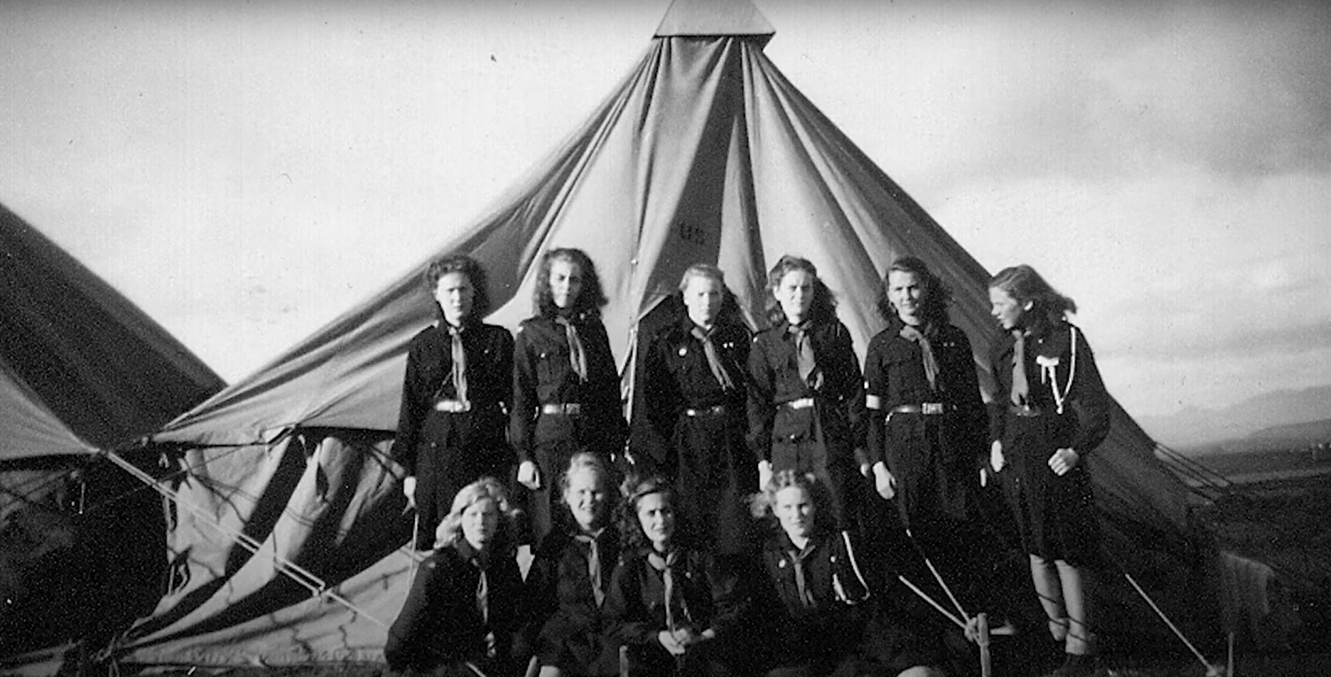
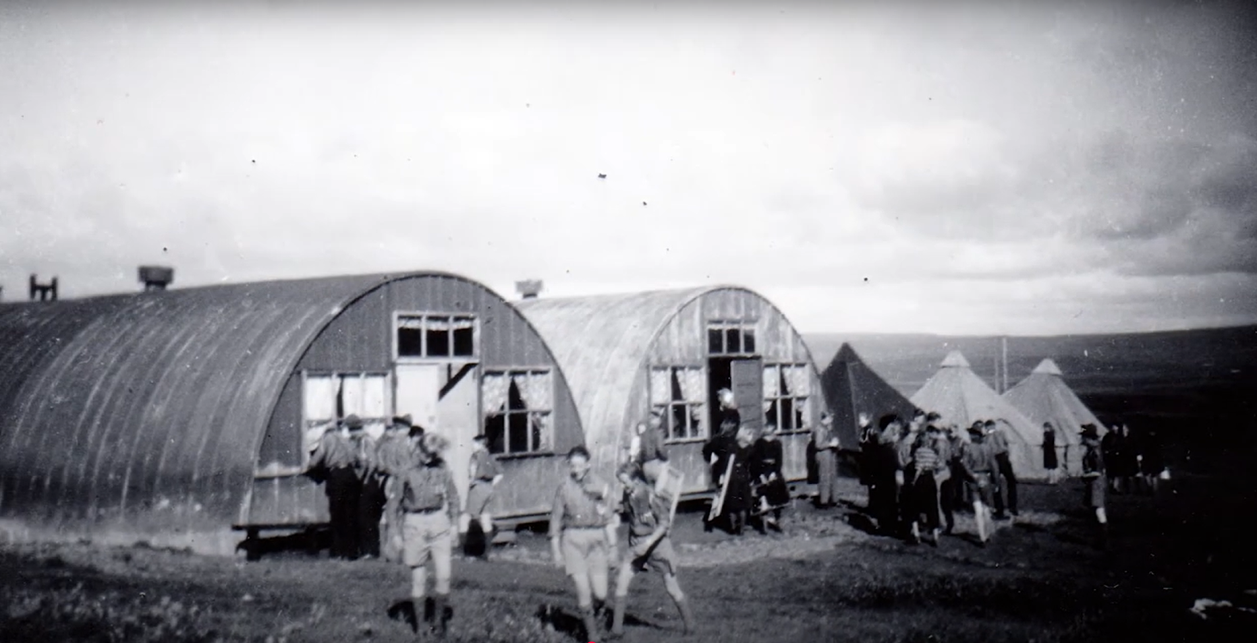

Slide 10
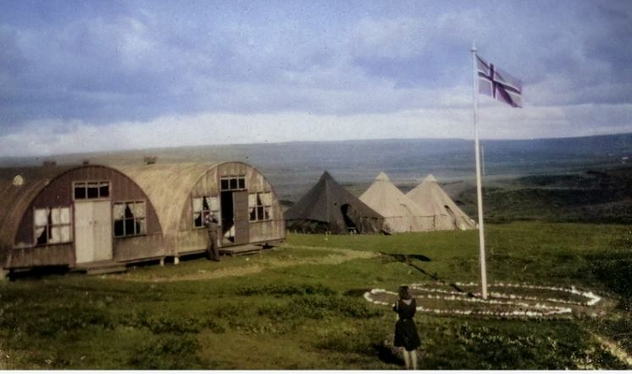
1945

Slide 11
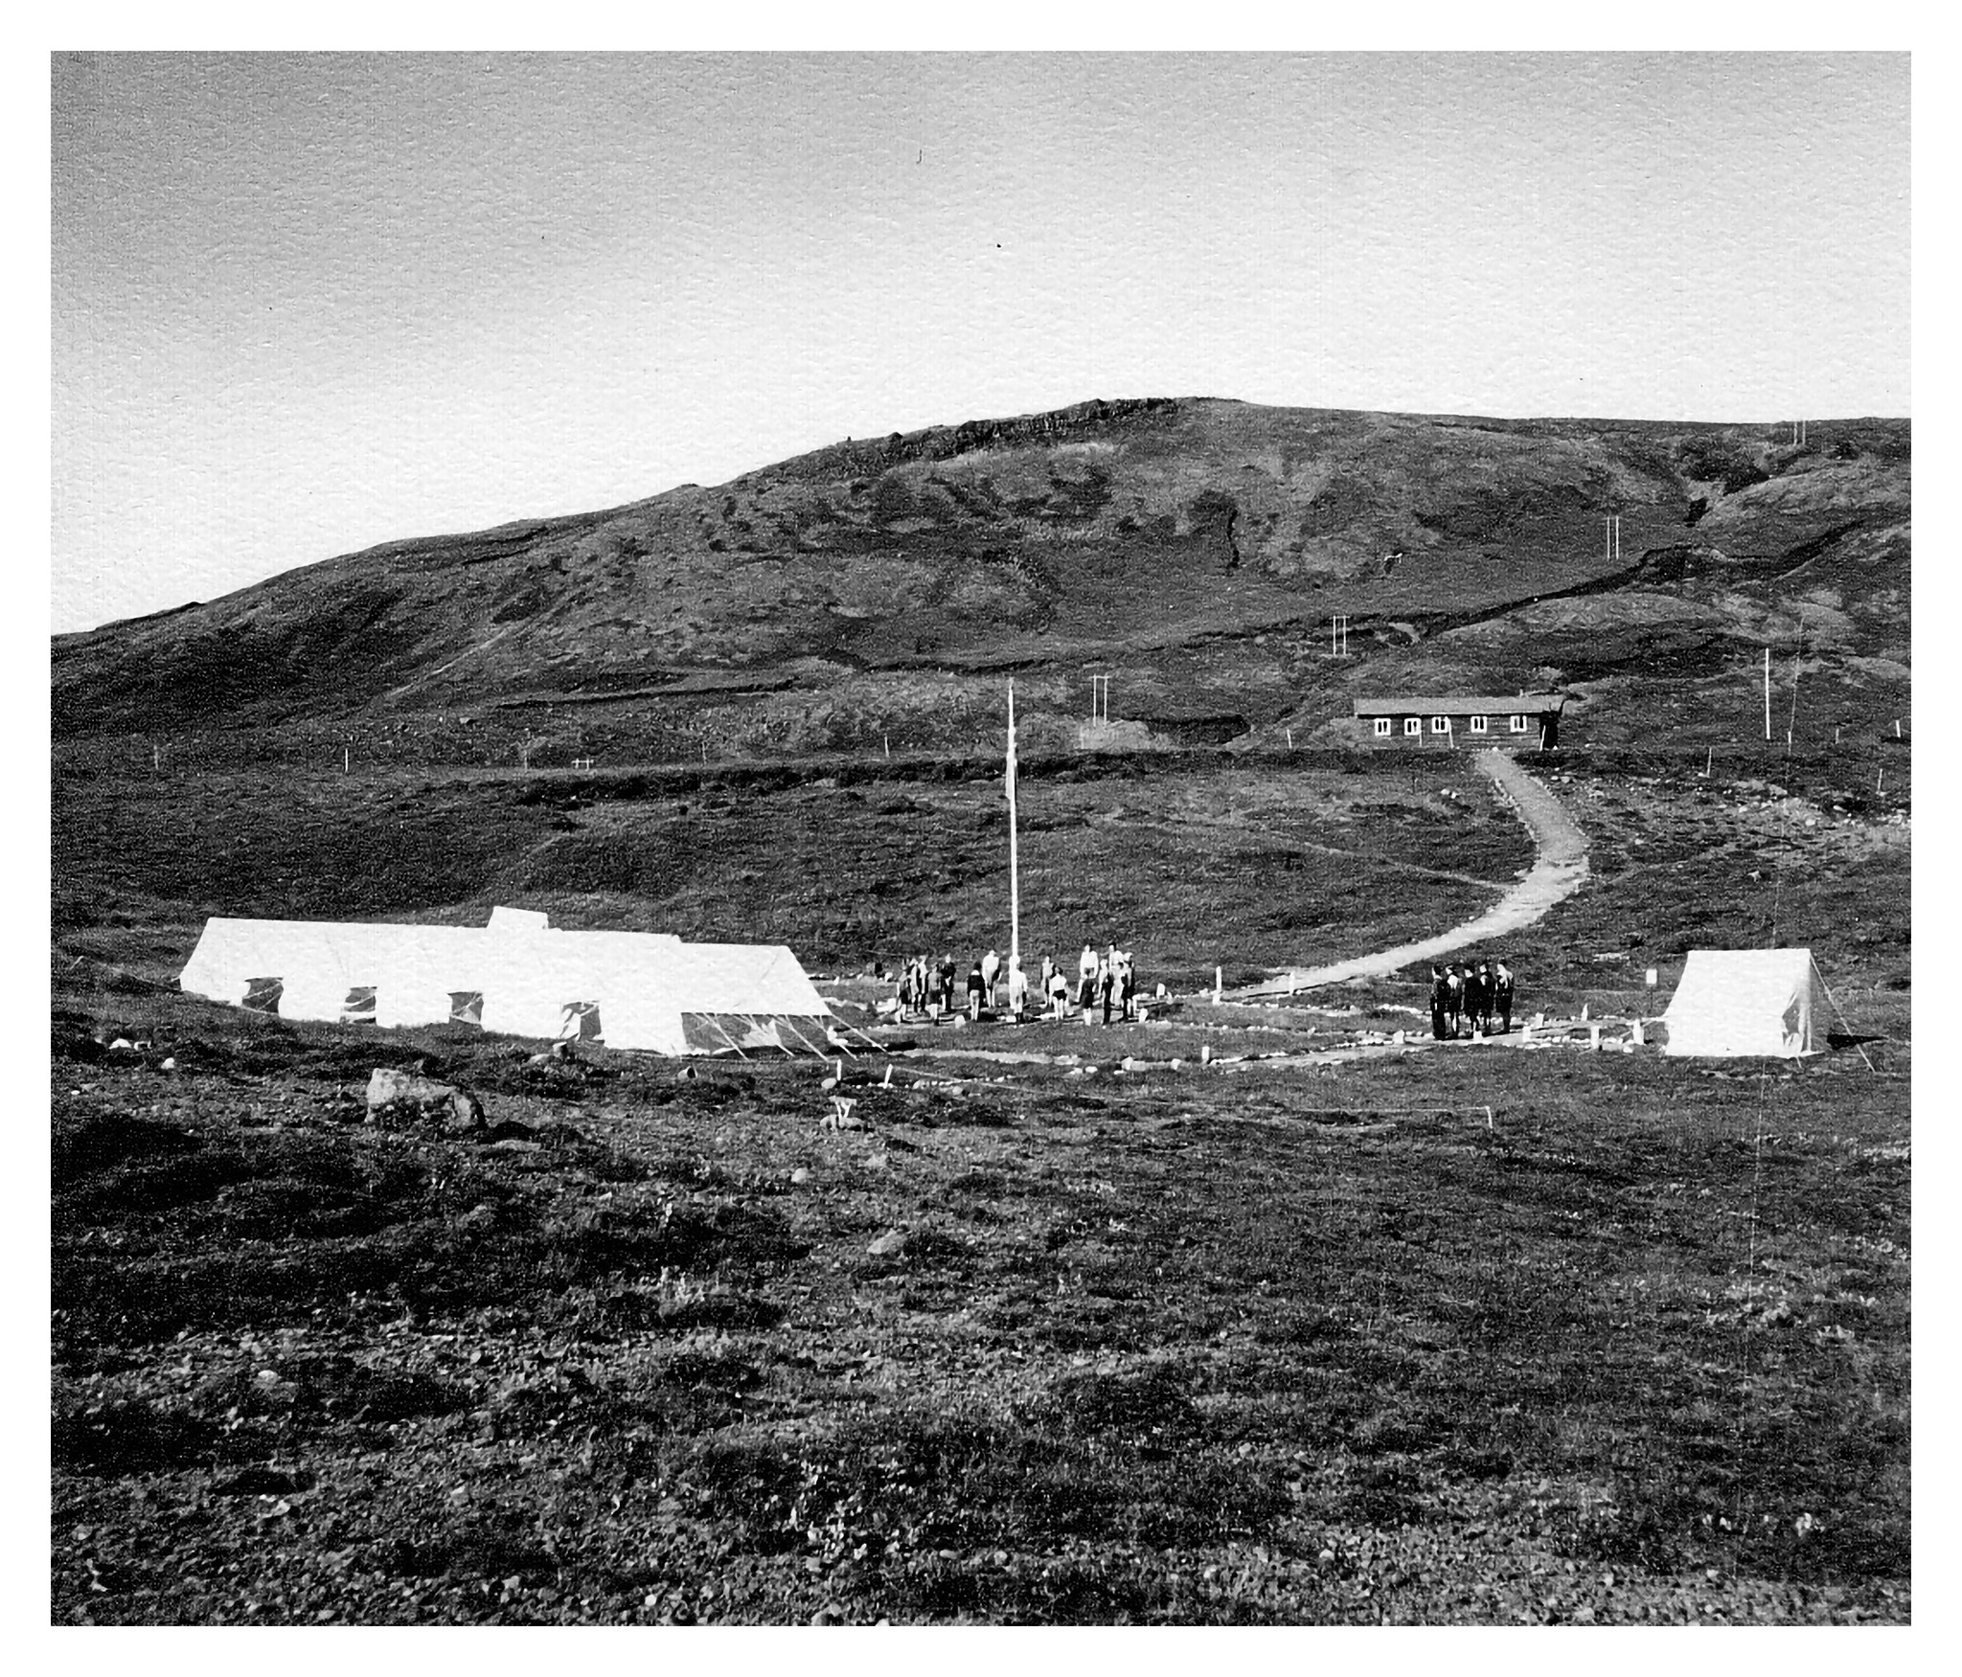
1940‘s

Slide 12
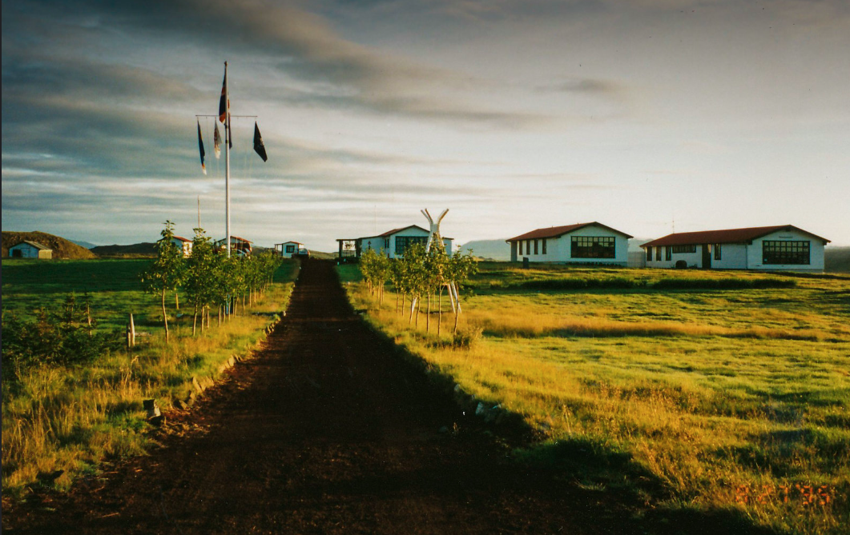
1995

Slide 13
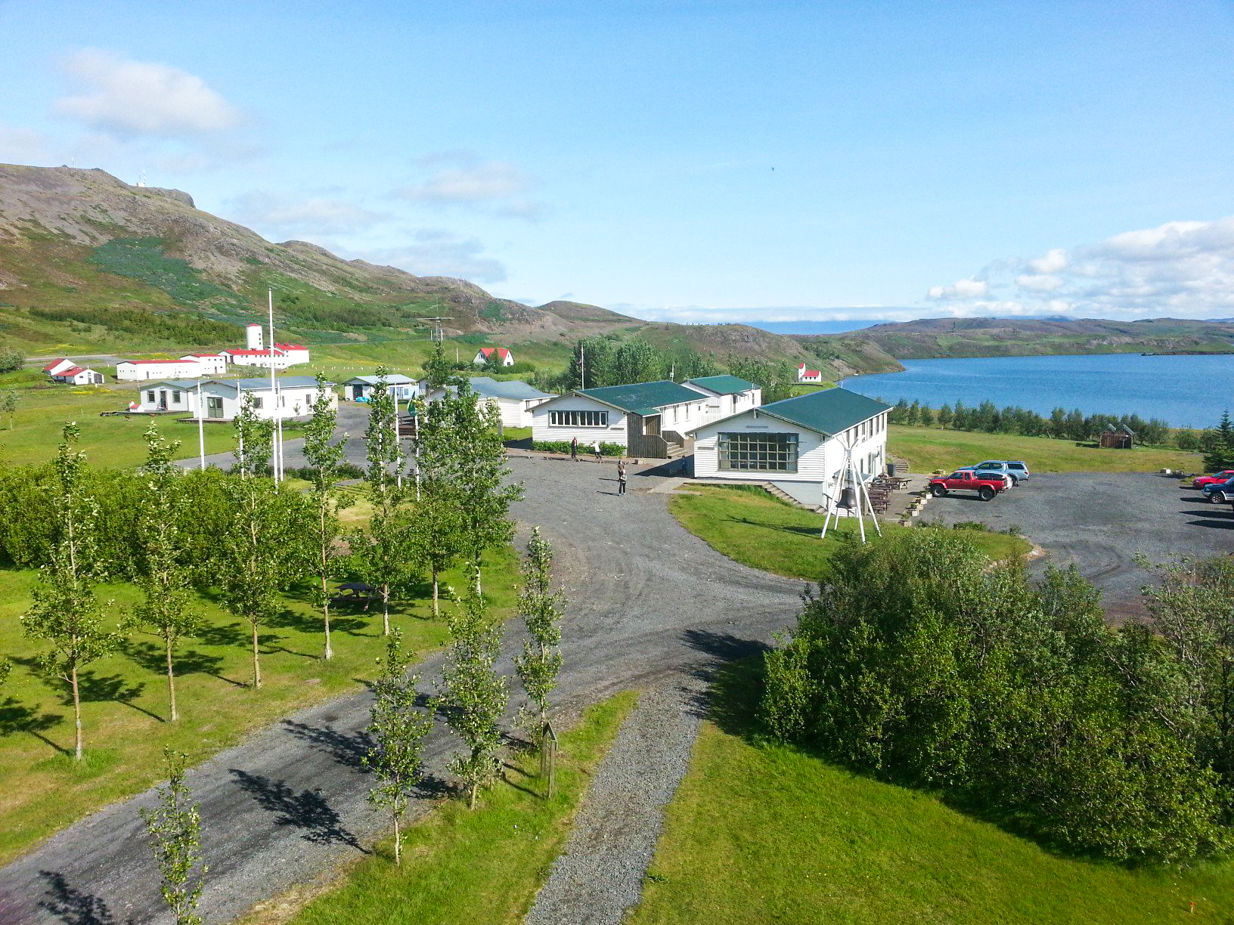
2016

Slide 14
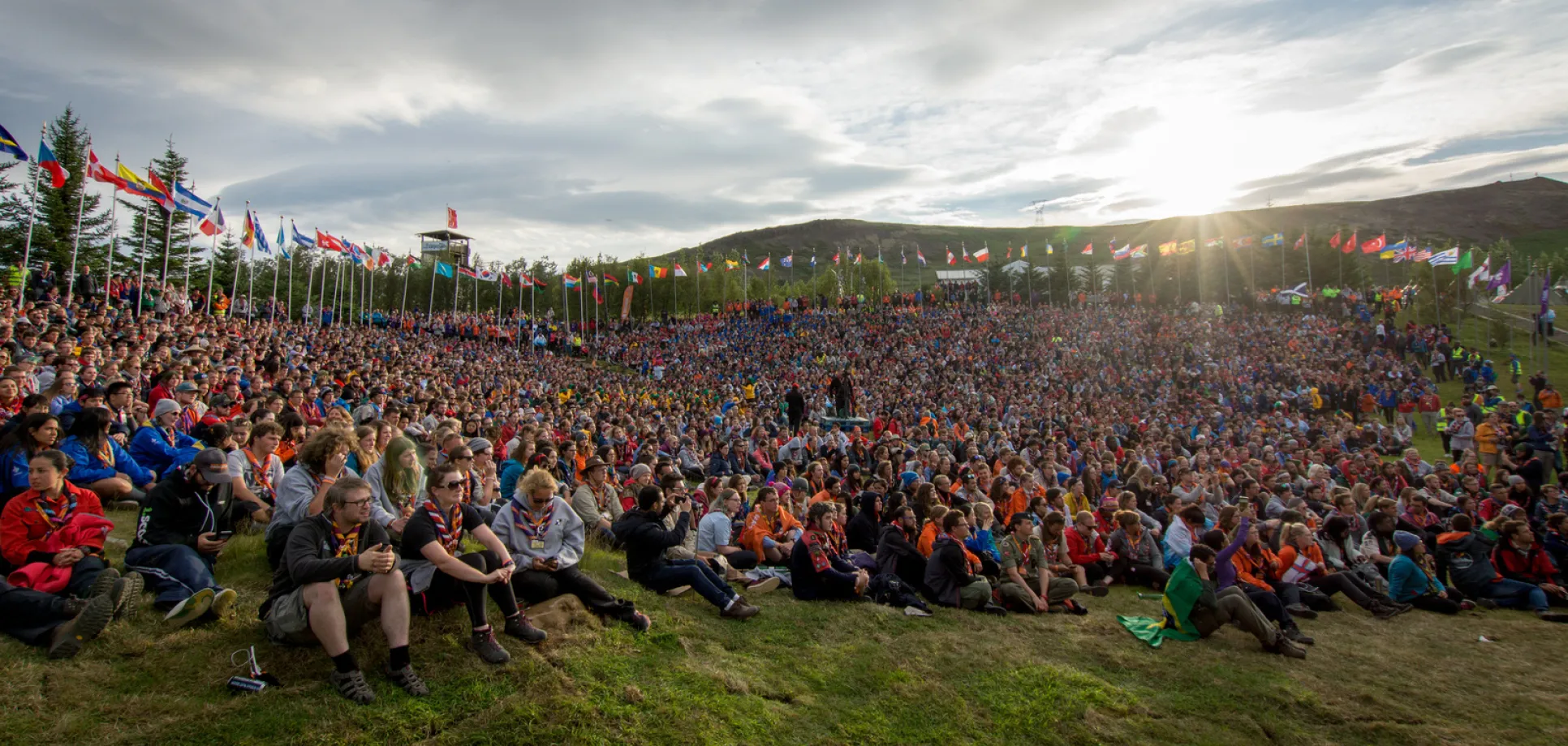


2017
1940‘s

Slide 15
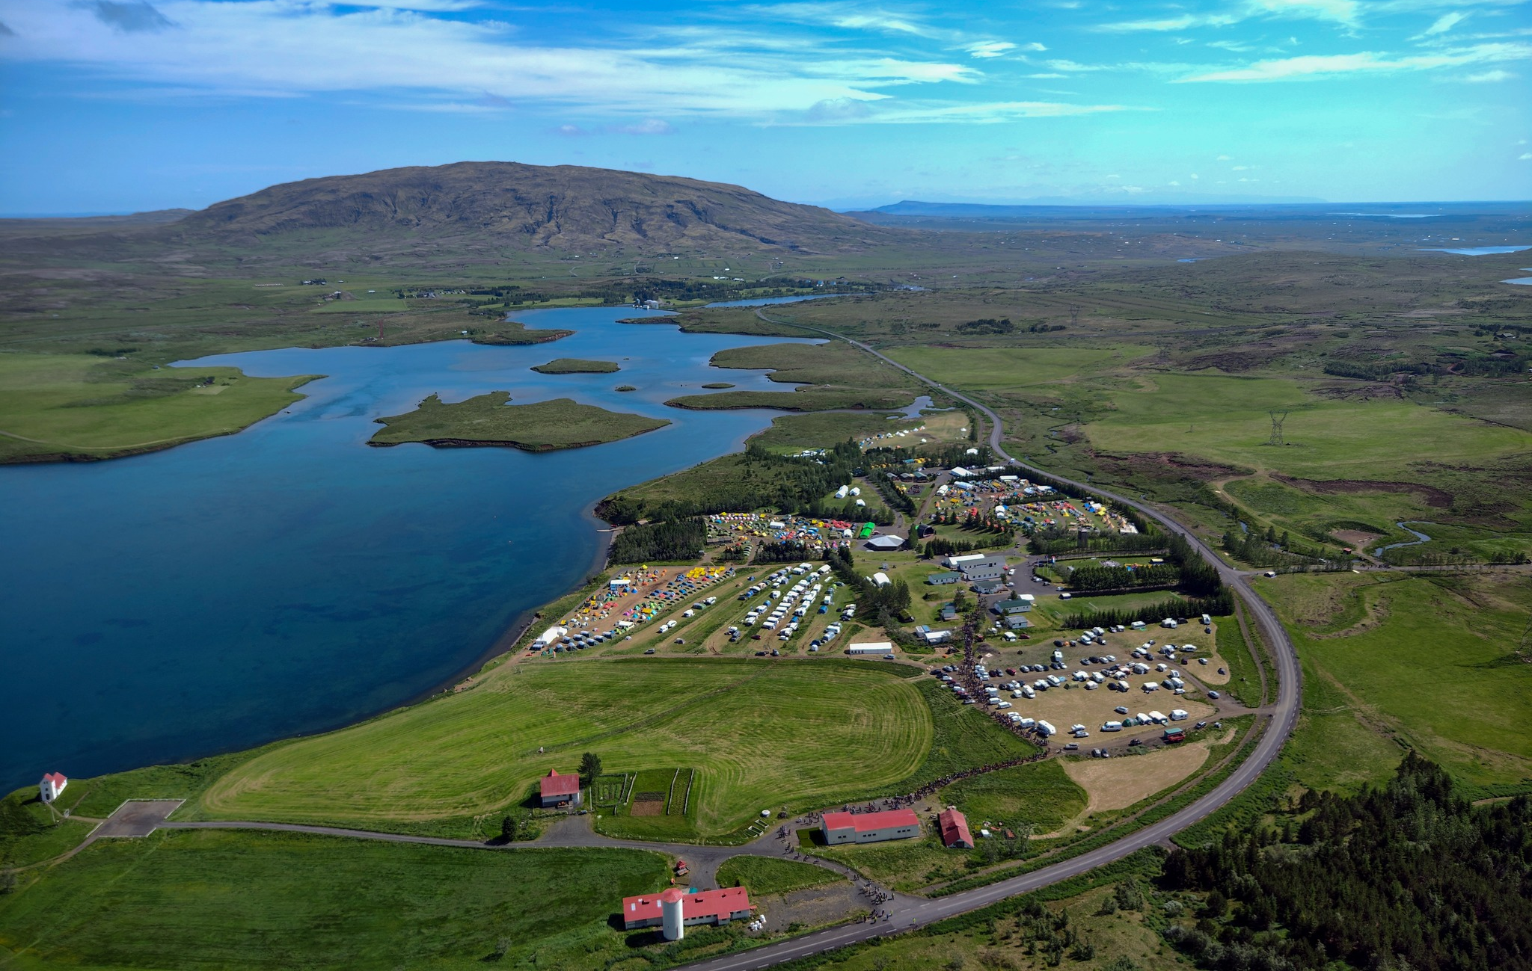
1940‘s
2024

Slide 16





Who are we?

Slide 17
Who are we?
School
camps
Summer
camps
Family
campsite
International
Scout groups
Home-field of Icelandic Scouts (events, training, etc.)

Slide 18
What do we do?
Our vision:
Inspired by the work of the Icelandic Scout Movement,
Úlfljótsvatn is known in Iceland and abroad
for offering an excellent Scout program,
first-class facilities for outdoor activities with sustainability as guiding principle,
and leading youth into outdoor life and education.
Úlfljótsvatn is where everyone wants to be,
an attractive workplace that gathers qualified staff and volunteers

Slide 19
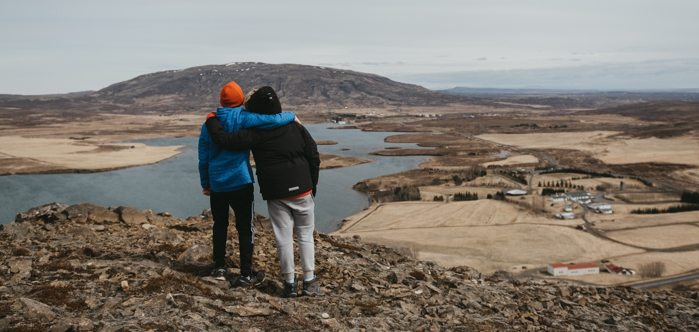
What do we do?
Úlfljótsvatn’s goal:
To provide an excellent Scouting environment for youth to experience the outdoors, with empowerment and sustainability as guiding lights.

Slide 20
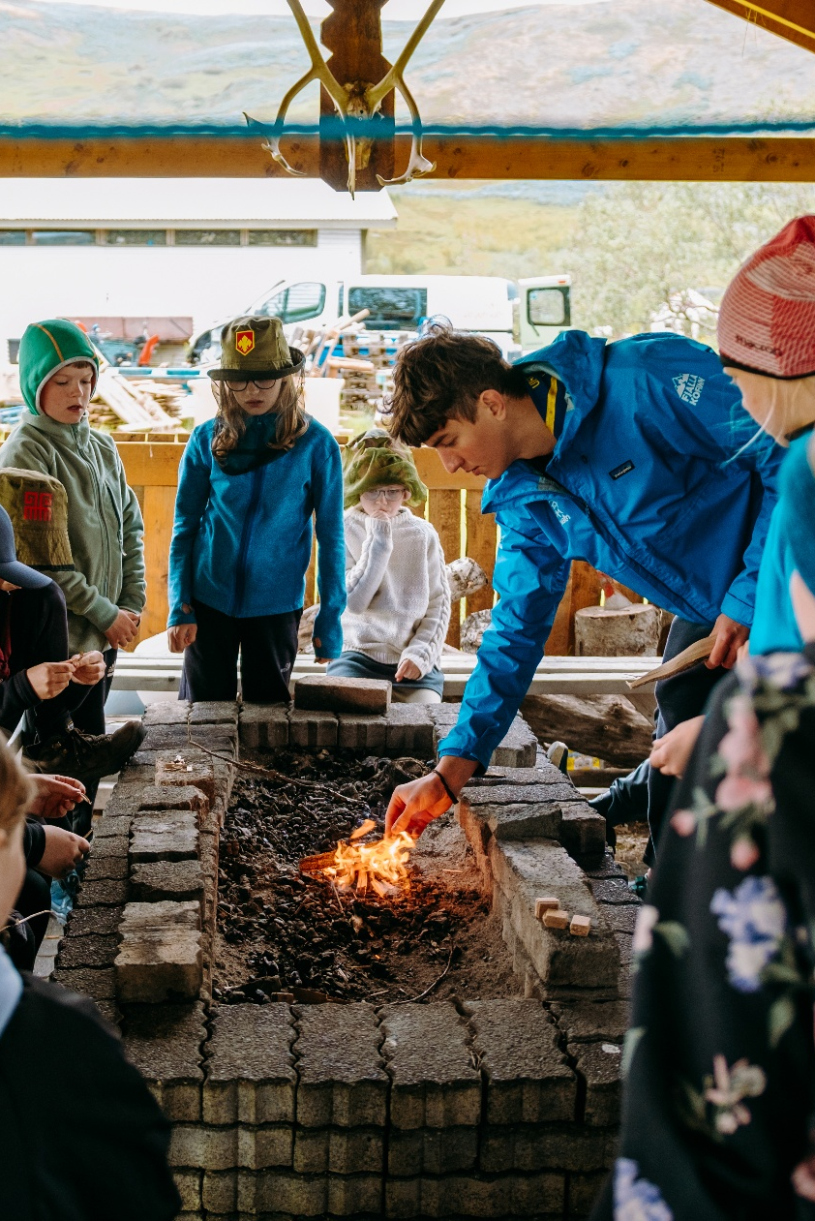
What do we do?
Our goal towards the Scout Movement:
To be the home-field of Scouting in Iceland, and a venue for big and small events
To be the center of Scout leader training
To offer young Scouts an opportunity to work in an international work environment and gain skills and experience that they will use in life

Slide 21
What do we do?
Our School Camp goals:
To improve participant’s communication skills,
self-image and respect
To improve participant’s outdoor activeness and nature awareness
To offer participants that don’t shine in a traditional school environment a chance to enjoy themselves in a new environment and discover new strengths
To help schools offer educational opportunities in non-formal education and outdoor education, and support various goals of the national curriculum

Slide 22
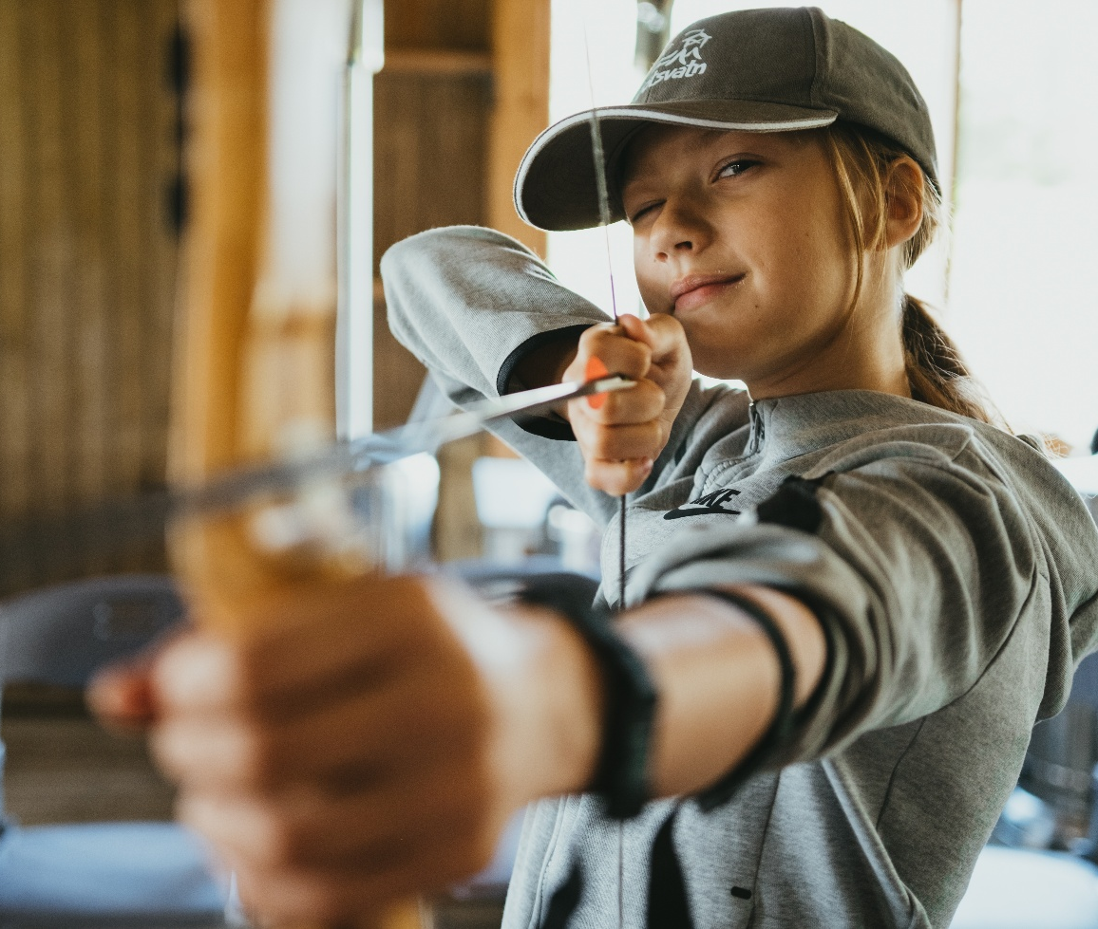
What do we do?
Our Summer Camp goals:
That children can experience nature
Introduce children to the exciting outdoor activities of the
Scout Movement
That children gain friends from a diverse group and enjoy themselves as individuals

Slide 23
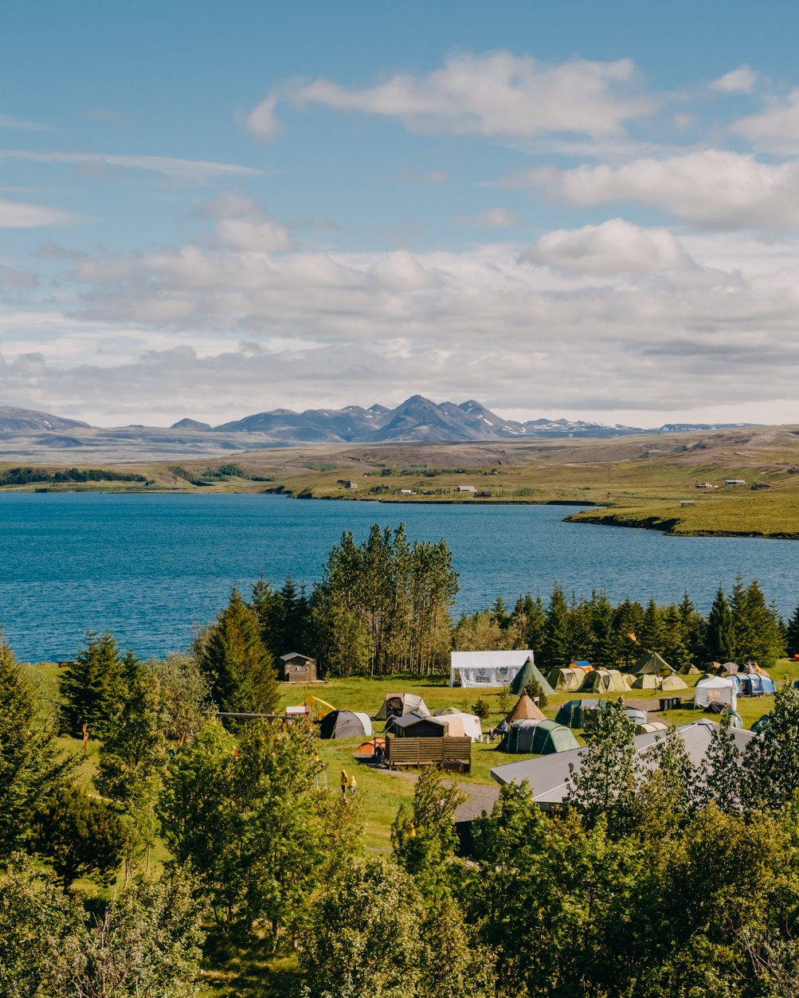
What do we do?
Our Family Campsite goals:
To offer families a safe environment for outdoor activities and wholesome family time
To introduce the public to the
Scout Movement

Slide 24
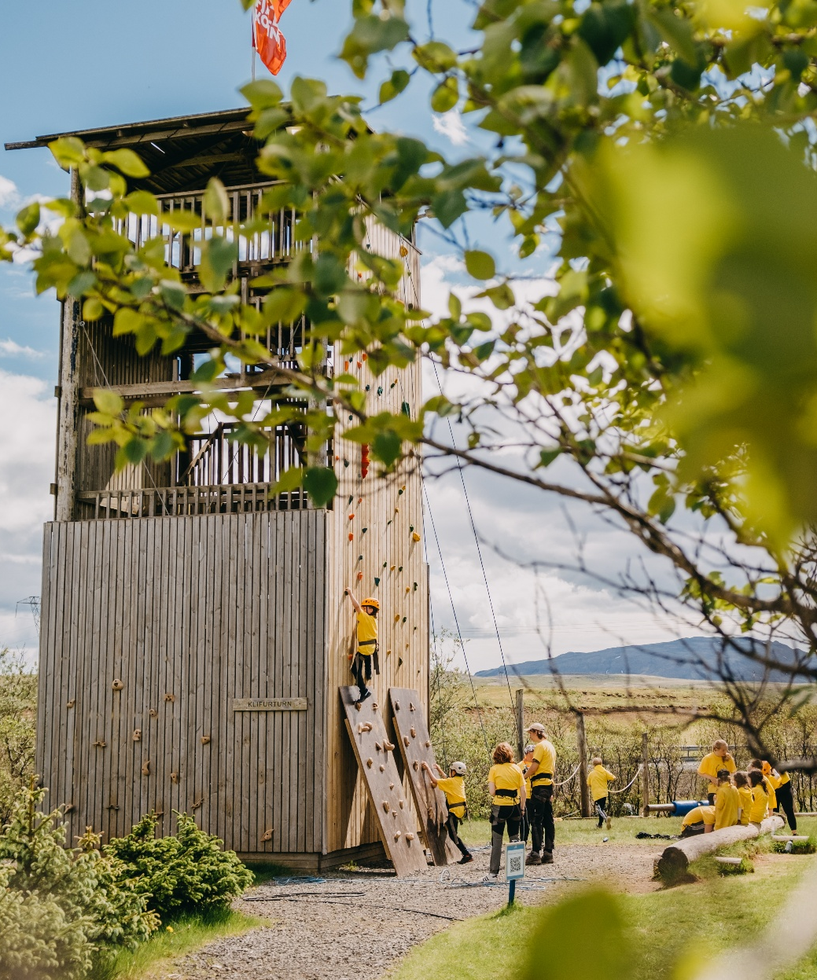
What do we do?
Our International Groups goals:
To give Scouts in Iceland an opportunity to get to know Scouts from other countries
To give young people from other countries a change to experience Iceland in a safe and cost-effective way
To be the venue for collaboration of international youth groups

Slide 25




What do we do?
Úlfljótsvatn’s values:
Belonging: At Úlfljótsvatn, our staff and guests should feel comfortable as if they are part of the place and not just visiting.
Adventure: We believe in the positive impact of the outdoors on people, so our outdoor program is a key part of our services.
Empowerment: We want to support young people, provide them with opportunities to challenge themselves and empower them to actively participate in society.
Scouting: The value and direction of the Scout movement is our guide in everything that we do at Úlfljótsvatn.

Slide 26
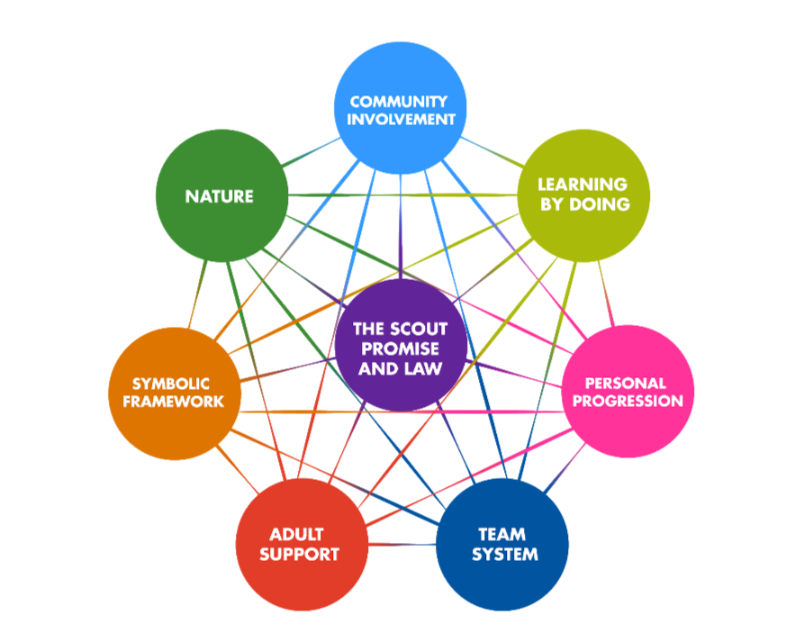
What do we do?
Scout Method

Slide 27
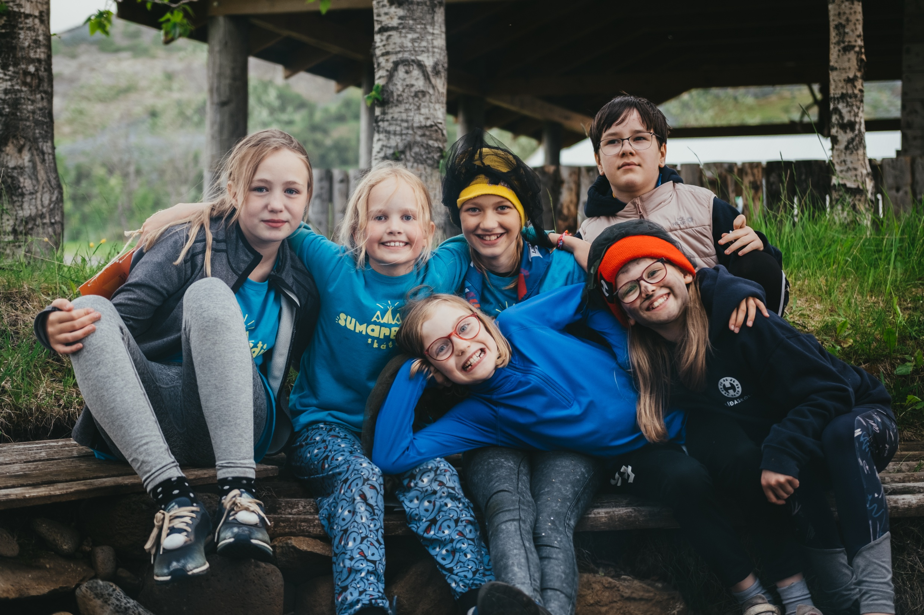
What do we do?

Slide 28
Meet the team
Board of NSO
CEO
(of NSO and Úlfljótsvatn)
Management Team
Operations Manager / Program Manager / Guest Services Manager / Camp Manager
Program Team
Program Manager
Program Coordinator
Program Assistant*
Guest Services Team
GS Manager (Chef)
GS Assistant*
Camp Team
Camp Manager
Maintenance Coord.
Campsite Coordinator*
Volunteers
The lifeblood of the center – Work across all teams

Slide 29
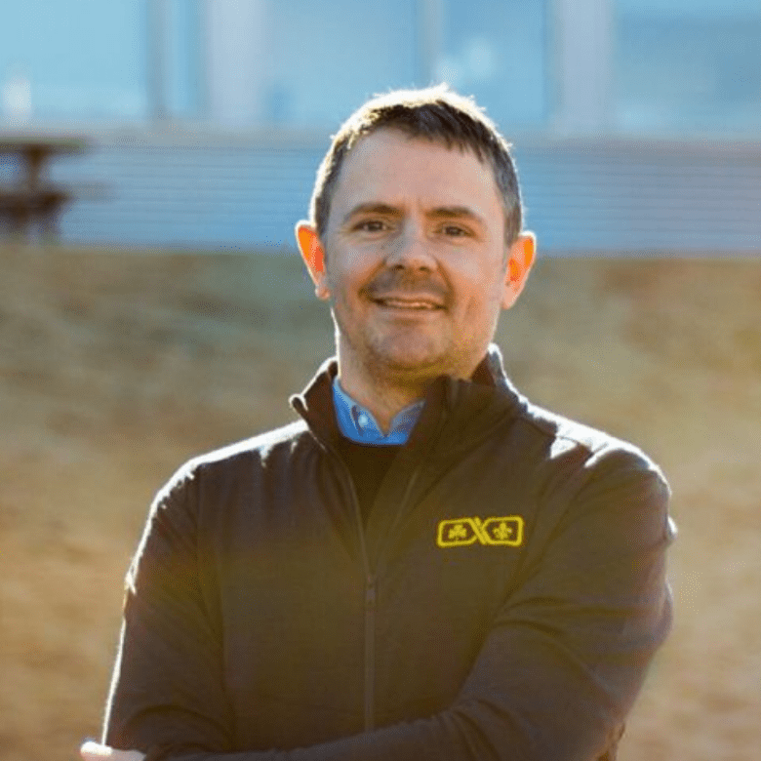
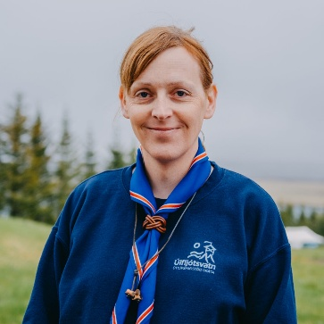
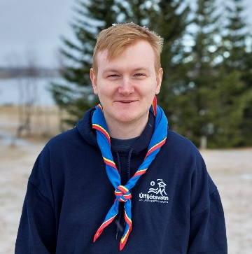
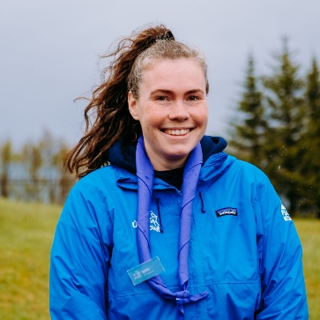
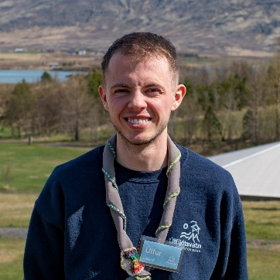
Meet the team
Raggi
CEO
Elín
Operations Manager
Ari
Chef
(Guest Services Manager)
Sjöfn
Program Manager
Úlfur
Camp
Manager

Slide 30
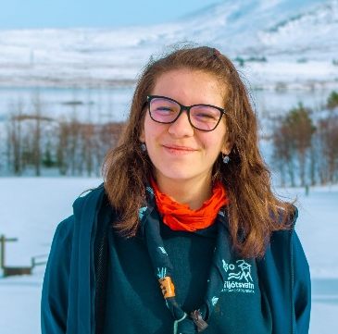
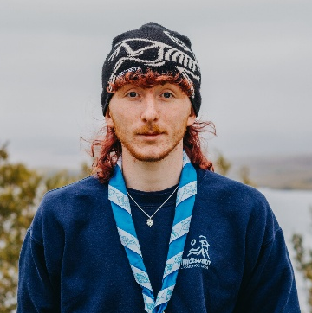
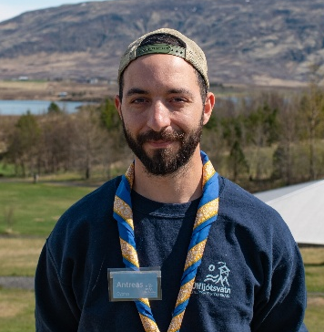
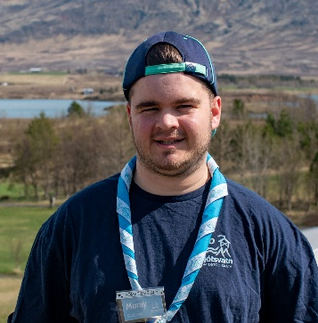
Meet the team
Andreea
Program
Coordinator
Alistair
Program
Assistant
Andreas
Maintenance
Coordinator
Moray
Campsite
Coordinator
Later in season:
André (GS assistant)
Jirka (Maintenance Coordinator

Slide 31
