Slide 1
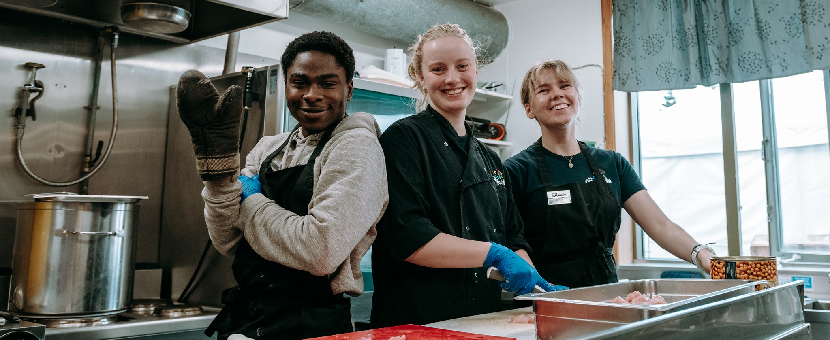
“Welcome to Úlfljótsvatn!”
- Providing Service -

Slide 2
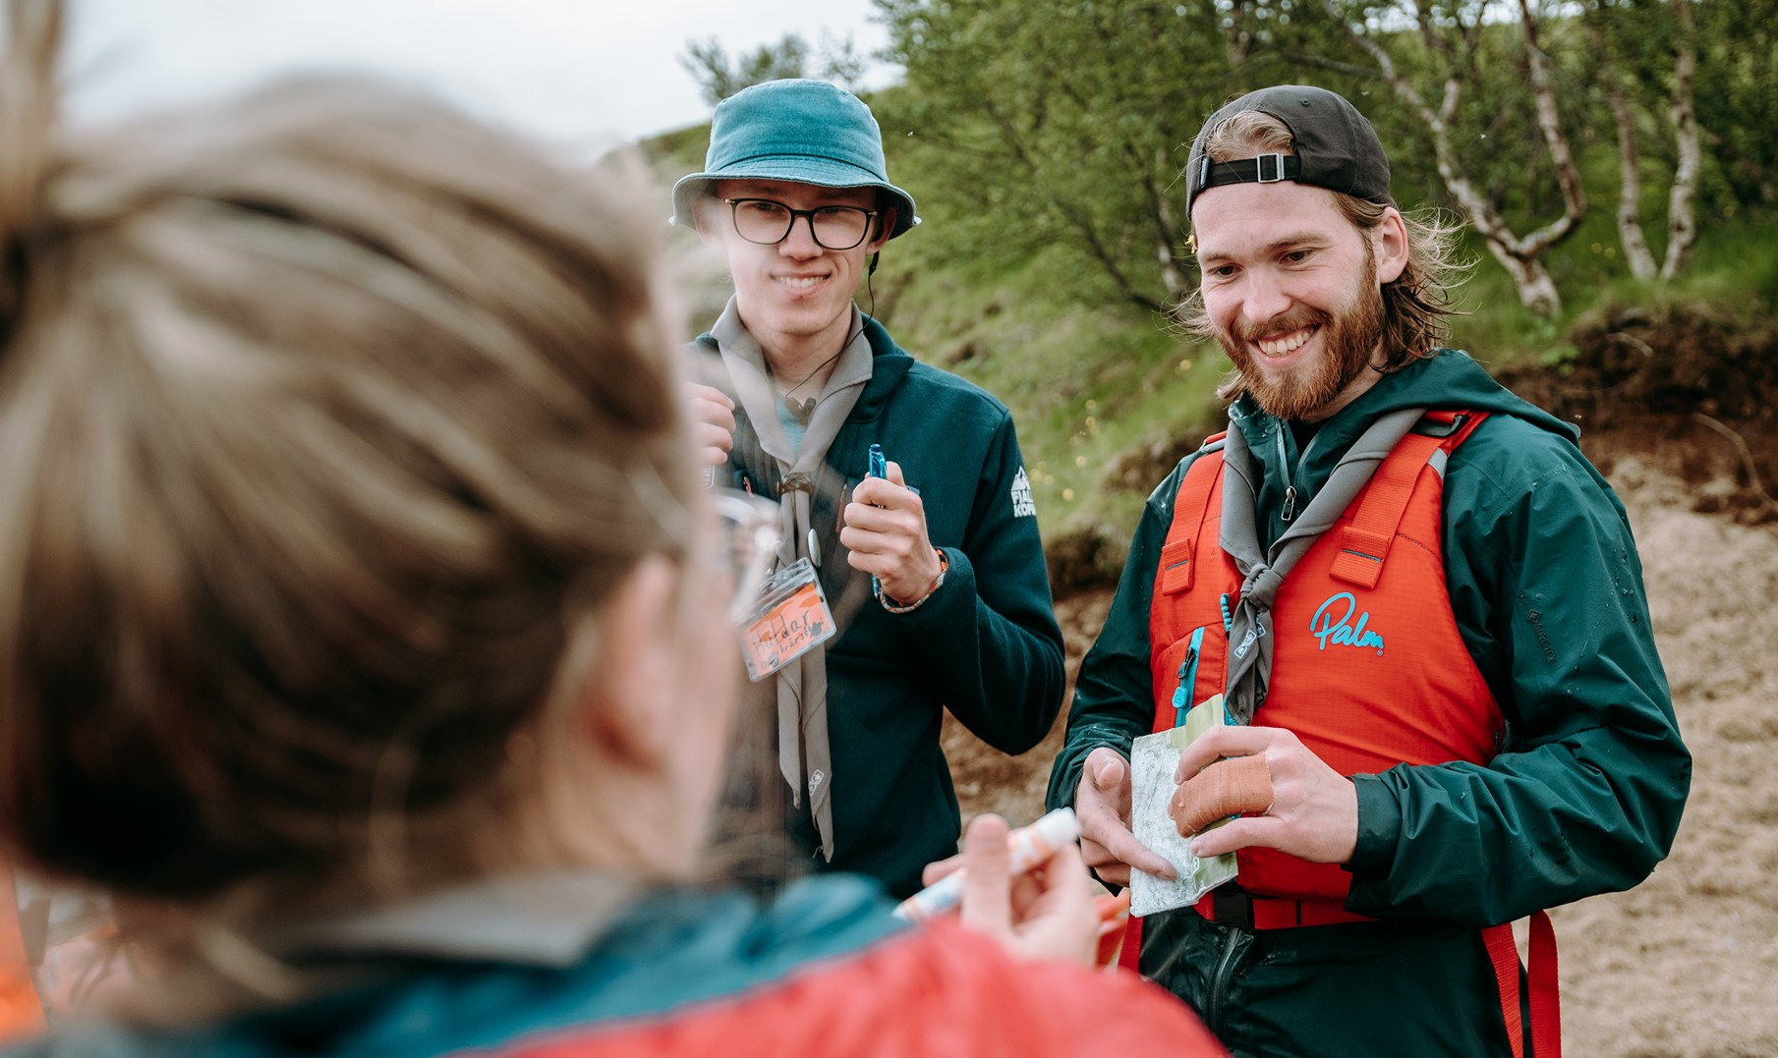
What is “service”?
Your ideas?

Slide 3
What is “service”?
Service provided at Úlfljótsvatn
School camps
Day trips
Icelandic Scouts (local groups, NSO events, etc.)
International Scouts
Unrelated groups (church, SAR, Erasmus+, Forestry, Landsvirkjun…)
Summer camps
Campsite

Slide 4
What is “service”?
Service provided at Úlfljótsvatn
Cooking
Cleaning
Running program
Taking care of site and facilities
Rental equipment
Bookings
On-site service (help with issues, etc.)

Slide 5
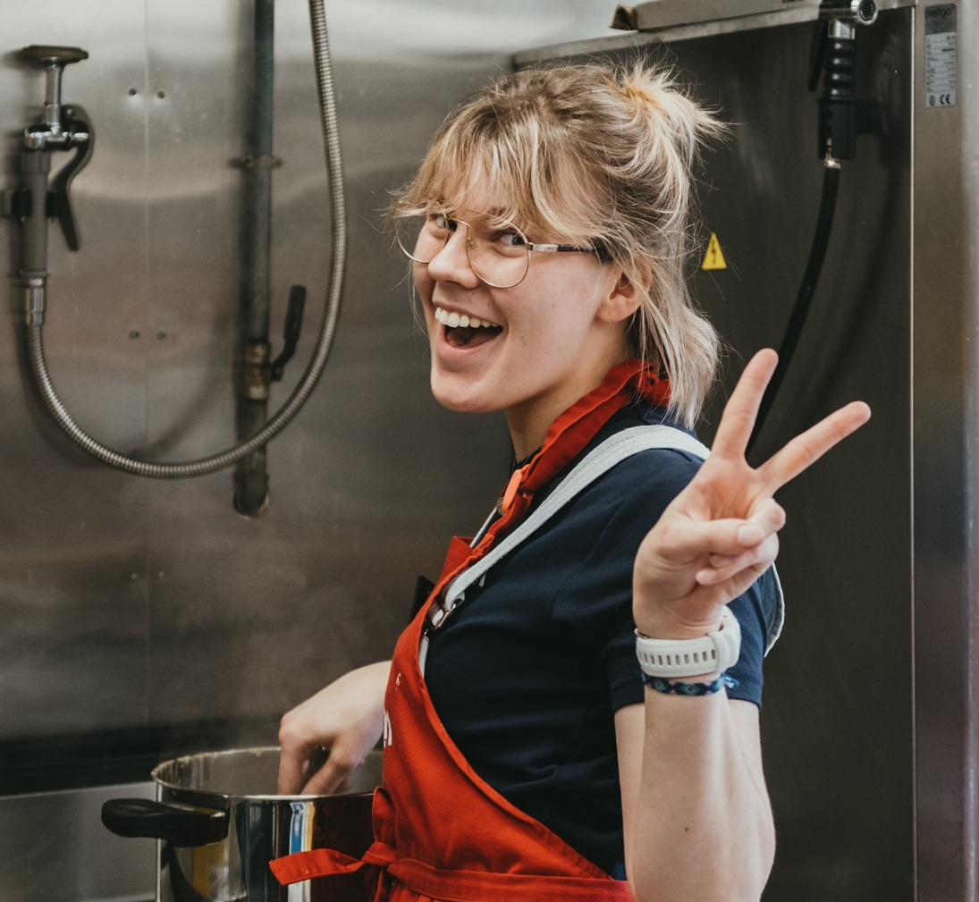
What is “GOOD service”?
Your ideas?

Slide 6
One definition of “service”
Service provided at Úlfljótsvatn
Speed
Knowledge
Personal assistance / Attitude
Dependability
Initiative
Image, looks and approach

Slide 7
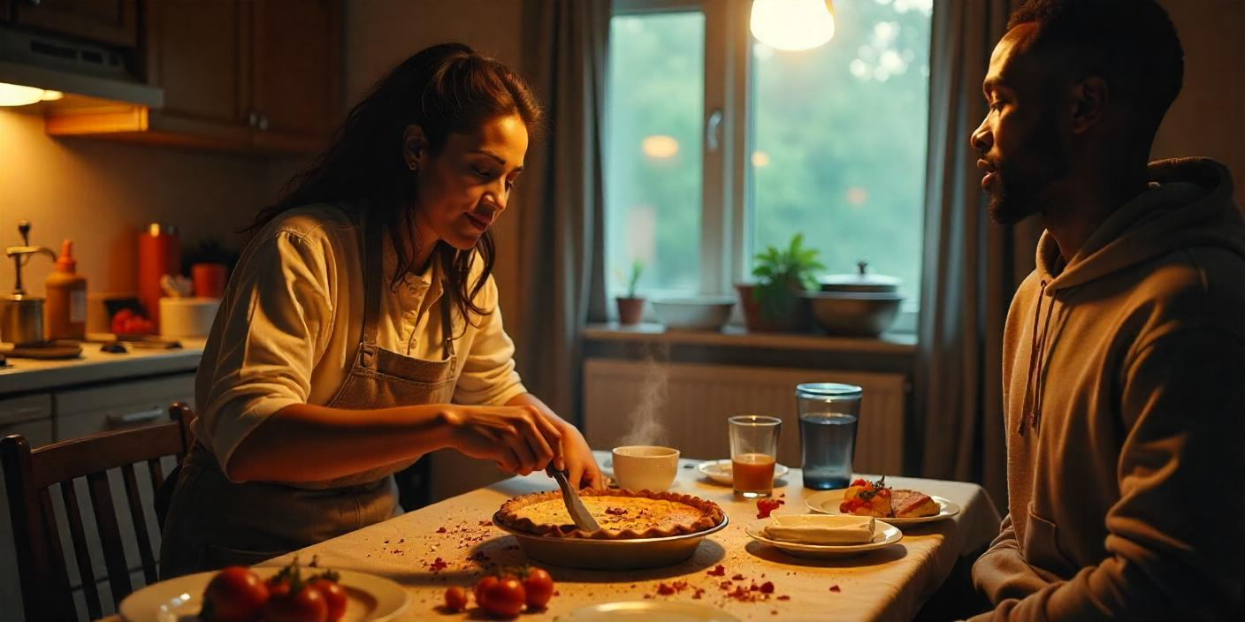
Dinner at your friend’s house

Slide 8
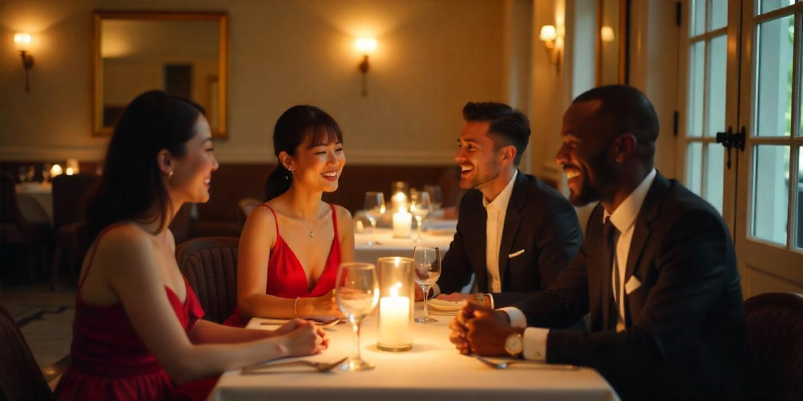
Dinner at a restaurant

Slide 9
Professionalism
… but … for volunteers
Use your uniform, be clean and tidy
Keep site and facilities clean
Enter your „pro“ mode (smile, positive, here to help)
„YOU“ are on hold
Use „Welcome to Úlfljótsvatn“ and „Thank you“ whenever appropriate
Do things WELL and QUICK, in a controlled manner
Resolve issues as quickly as possible

Slide 10
Professionalism
… but … for volunteers
Talk about „guests“, not clients or customers
Do your best to make sure the guests have a great experience
Be well prepared, on time and knowledgeable
Support each other and help each other to achieve our common goals
When with young guests, you are NOT their friend - you are a friendly professional

Slide 11
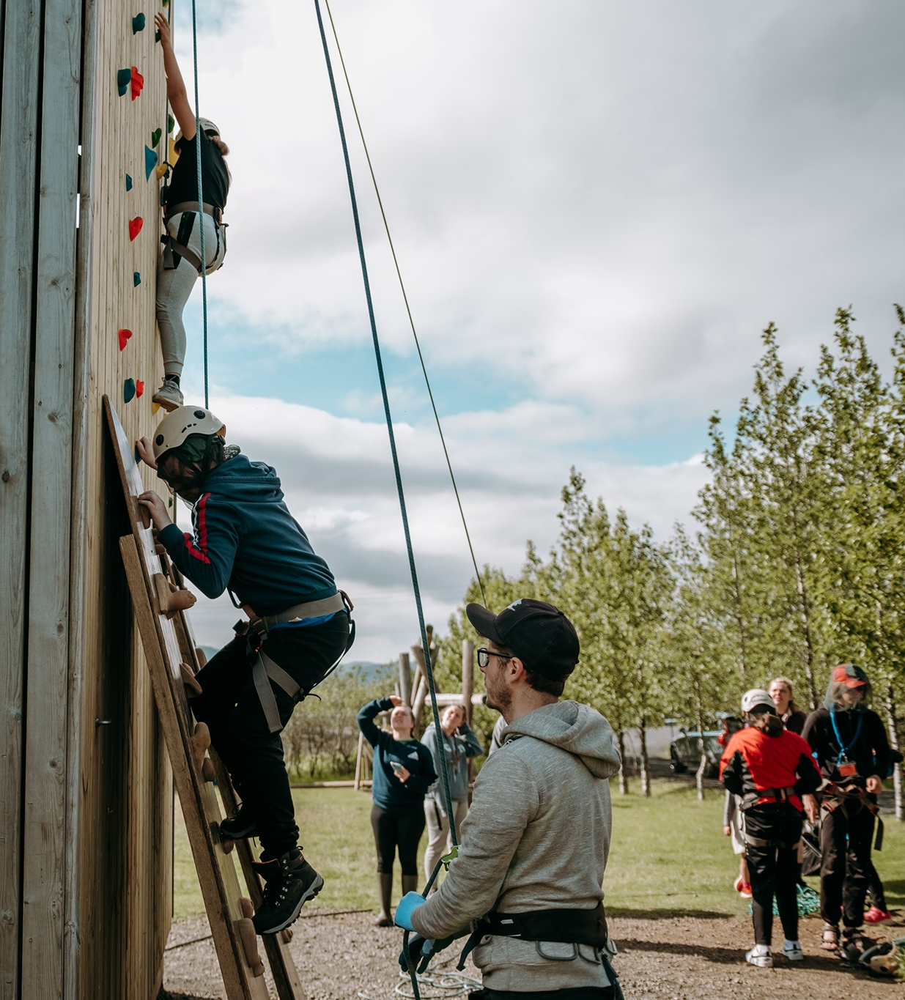
The Little Bit Extra

Slide 12
The little bit extra
Going from good to great
THINK proactively and DO well
Understand the goal, aim to reach it
See if all reasonable needs are being met
Take „ownership“ of the centre, so that you can be proud of it

Slide 13
Practice
Case 1
Guest: You would really like to have more Pítusósa with your milky rice. You will be quite unhappy if you can‘t.
Staff:
There is no more Pítusósa.

Slide 14
Practice
Case 2
Guest: You would like to complain that when your group was doing a climbing session, the staff member had earpods in and wasn‘t listening or talking to the scouts.
Staff:
Make the guest happy.

Slide 15
Practice
Case 3
Staff 1: You are left alone with take-down of the climbing activity. It is raining and you are hungry.
Staff 2:
You walk past.

Slide 16
Practice
Case 4
Guest: You are a group leader. Your group is camping. It is raining bucket loads and your gear is all wet. You would like to move to an inside accommodation.
Staff:
There is no indoor accommodation available.

Slide 17
Practice
Case 5
Guest: You are a kid in summer camp. It‘s 23.30 on your first night and you‘re feeling very homesick. You want to call your mom and go home.
Staff:
Comfort the kid and help them fall asleep.

Slide 18
Practice
Case 6
Guest: You are camping with your friends on the campsite. You are drunk. It‘s past midnight and you would very much like to be loud and play your favorite song on repeat at maximum volume.
Staff:
Your only goal in life right now is to have peace and quiet on the campsite, without being rude.

Slide 19
“This is how we do it”
- Code of conduct -

Slide 20
Documentation
Extract from HR-policy, and Youth Forum’s Code of Conduct
www.ulfljotsvatn.is/training

Slide 21
Code of conduct
Simplified (1/3)
Staff must be qualified to work with children
Welfare of children #1 priority
Healthy, constructive and safe work with children
Role models and good behavior
No alcohol, tobacco, etc.
Communicate in a good way
Diligence, honesty and respect

Slide 22
Code of conduct
Simplified (2/3)
No discrimination
Maintain confidentiality – unless you suspect neglect/abuse
Never put health and safety at risk
No bullying or violence of any kind
Respect individual differences
Keep professional distance
Be professional in electric communication

Slide 23
Code of conduct
Simplified (3/3)
Those in position of responsibility must be aware of the responsibility and the difference that their position creates them
No abusing of positions towards participants or colleagues
No sexual flirting or communication between adults and under 18‘s
No sexual flirting or communication between people in position of power and others
Staff must avoid to be alone with participants
Respect privacy of children when taking photographs

