Slide 1
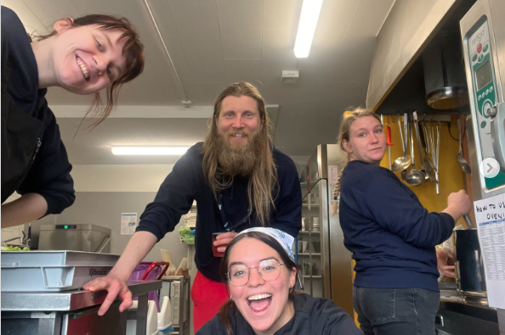
The Practicalities
An introduction to life at Úlfljótsvatn
www.ulfljotsvatn.is/training

Slide 2
Apps for your phone
Sling and Slack

Slide 3
Weekly meetings
Every Friday (when possible)
After group departure
30 minutes: Volunteer meeting / Coordinator meeting
45 minutes: Staff meeting
15 minutes: Operational meetings
After meeting: Cleaning
In meetings we sync the team, share information and evaluate the week.
Remember: Our „doors“ are always open ☺

Slide 4
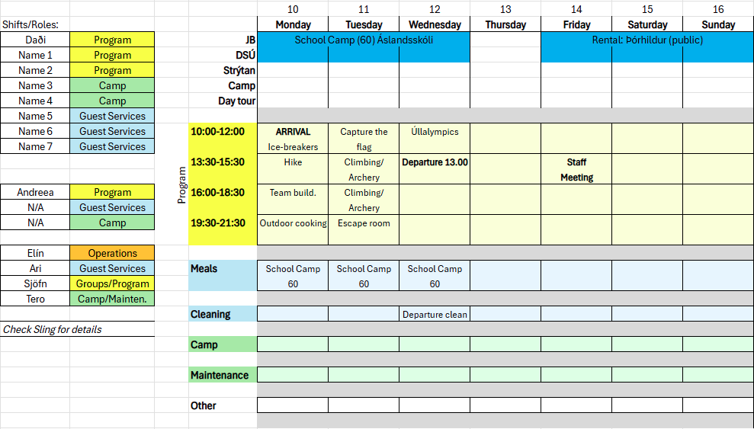
Weekly Overview

Slide 5
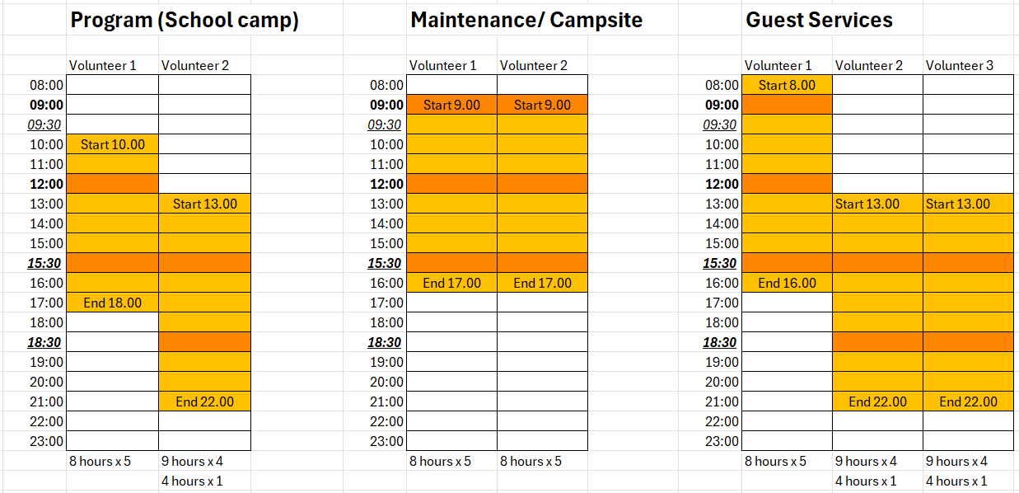
Shift Times - Example

Slide 6
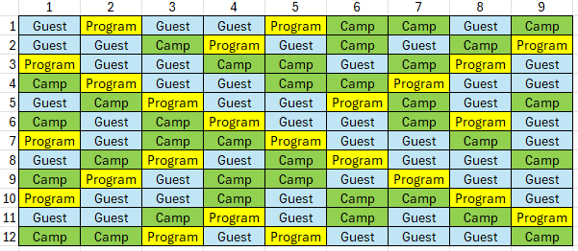
Shift Schedule

Slide 7
Staff Benefits
What you get
Free accommodation and meals during work and days off
2 days off per week
Use of centre equipment (when not in use by guests)
Provided with bedding and towels, as well as laundry facilities
Regular staff activities (SEA / SADA)
Use of center vehicle (Yaris)

Slide 8
General Centre Rules
Do’s and don’ts
Work-day starts on the minute (DON'T BE LATE)
Full uniform must be worn during work times
Uniform should be removed while not working
If sick or unable to work, notify managers ASAP by Slack
No alcohol on site
Alcohol should not be consumed by those under the legal age (20)
Be nice to each other

Slide 9
Communication is Key
Be respectful to each other, guests and the center
Plant happy seeds – say nice things to each other
Stay away from passive aggression, favoritism, exclusion, bullying and other bad habits
Respect the needs of others, such as personal space, alone time and so on
Accept that others may not have the same needs, habits or believes as yourself
If you need to, give constructive feedback
Keep in mind that lack of sleep can affect mental health – take care of yourself and others
If you have any concerns, feel free to talk to any of the managers

Slide 10
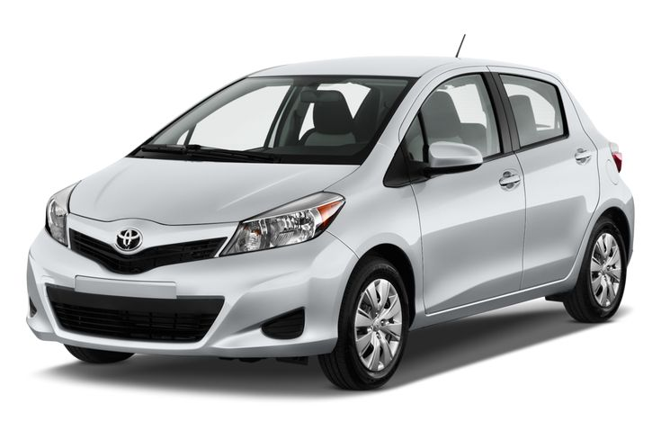
Cars
Hilux and Yaris
Hilux is a work vehicle
Not to be used for personal use or trips (few exceptions)
Yaris is for personal use and trips
Drivers need to do assessments and sign an agreement Driver is responsible for the car
Users pay for fuel

Slide 11
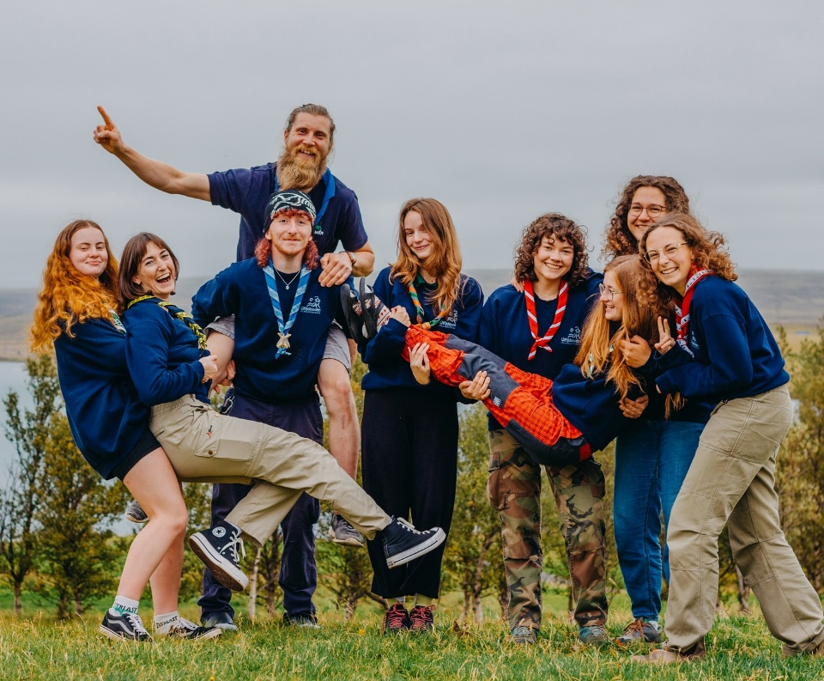
Finally…
Keys Put your name on the label NOW. Do not lose them. Shifts Option to change schedules today Option to change shifts (with approval of manager)
Photos
On Friday, at end of training With neckerchief, in staff uniform (also group photo)

Slide 12
